Slide 1
Measuring innovation in education
17. Pedagógiai Értékelési Konferencia
17th Educational Assessment Conference
Szeged, 2019 Április 13
Gábor Halász
ELTE/OFI Budapest
Click on pictures in orange frame!
This presentation is based on the outcomes of the research projects entitled „The emergence and diffusion of local innovations and their systemic impact in the education sector” (No. 115857)

Slide 2

Innovation research in education: the background
Innovation is seen as a
major source of improving
effectiveness in the public
sector, including education
Challenges:
  How to adapt national innovation
  strategies to the specific
  education sector context
  How to measure innovation
  in the education sector

Slide 3

The „Innova” project:
„The emergence and
diffusion of local innovations
and their systemic impact
in the education sector”
A project funded by the Hungarian National Research,
Development and Innovation Office (2016-2020)
Including a pilot national education sector innovation survey

Slide 4
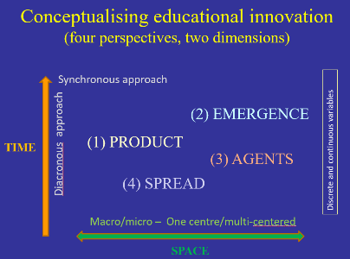
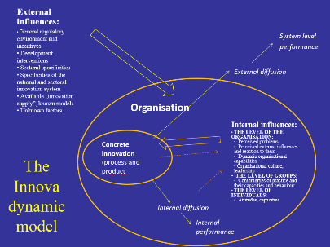
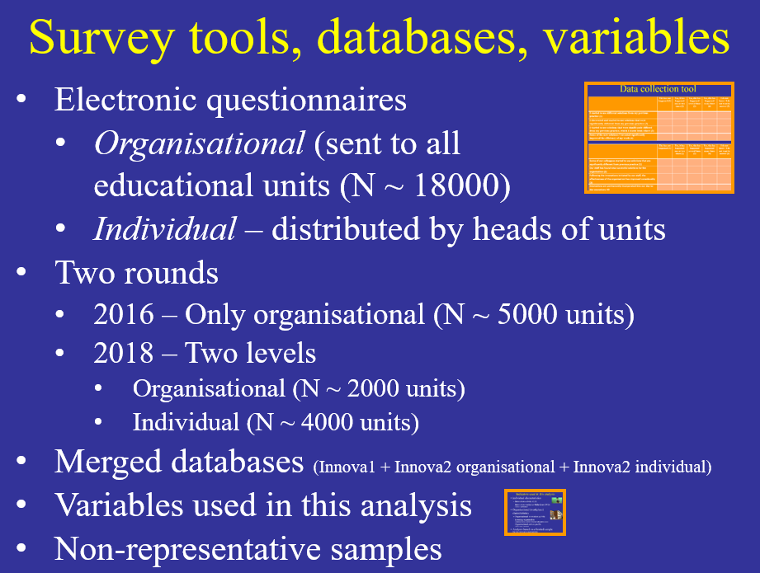
Conceptualisation and survey tool
The analytical framework
(defining relevant
perspectives and dimensions)
Designing theoretical models
(both static and dynamic)
Survey tools and
data collection
  All subsystems (a major challenge!)
  Organisational and individual level
  General processes and specific innovations
  (subject and object based approaches)
  Contextual variables

Slide 5
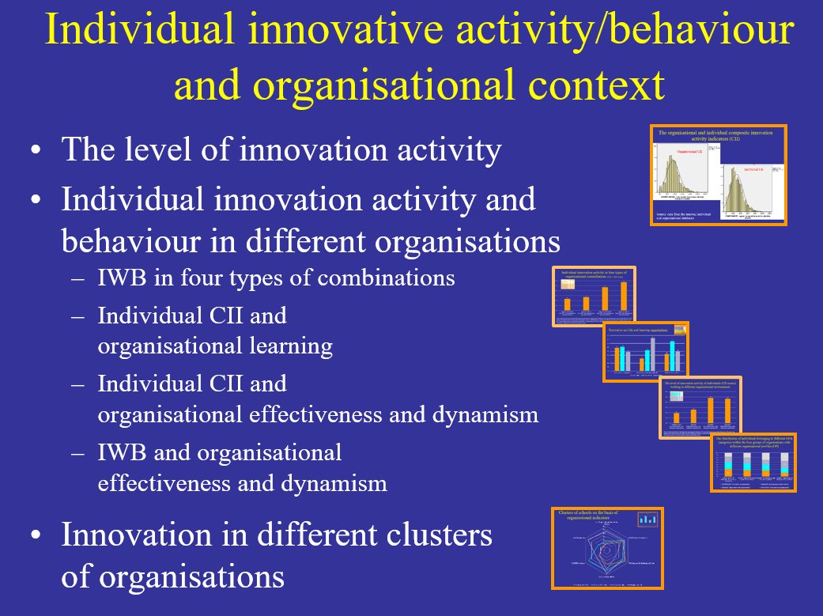
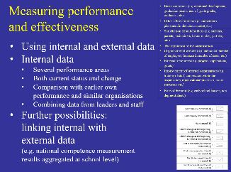
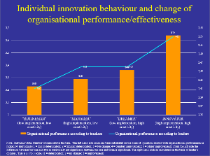
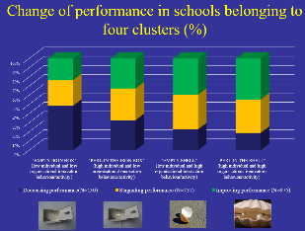
Some examples of outcomes:
Innovation and organisational characteristics
Innovation activity/behaviour
and organisational characteristics
Innovation activity/behaviour and organisational performance
  How to define performance?
  Does innovation support
  performance?
  Complicated causal relations:
  - There are too many kinds of innovations
  - Low performance may trigger innovation

Slide 6
Some conclusions (1)
Innovation in the education sector is measurable – an education sector innovation survey is possible.
There is a high level variance in the innovation activity of both individuals (teachers) and organisations (schools)
The creation of individual and organisational level innovation indicators allows the analysis of the relationship between workplace characteristics and the innovation activity/behaviour of individuals

Slide 7
Some conclusions (2)
There is a rather strong relationship between the organisational characteristics of workplaces (educational units) and the innovation activity/behaviour of their employees (teachers)
(Bottom-up) innovation might be a source of performance improvement

Slide 8
Thank you for your attention!
This presentation is based on the outcomes of the research projects entitled „The emergence and diffusion of local innovations and their systemic impact in the education sector” (No. 115857)
halaszg@helka.iif.hu

Slide 9

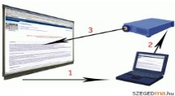

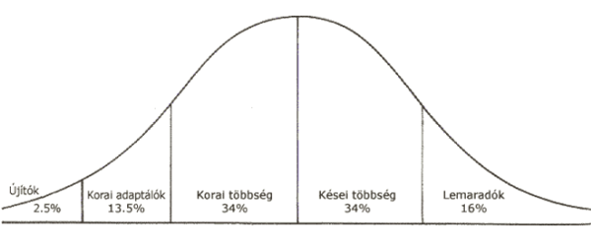
Conceptualising educational innovation
(four perspectives, two dimensions)
(Download the detailed model from here)
Synchronous approach
(2) EMERGENCE
(process)
Diacronous approach
(1) PRODUCT
Discrete and continuous variables
TIME
(3) AGENTS
(4) SPREAD
(process)
Macro/micro – One centre/multi-centred
SPACE

Slide 10
External influences:
General regulatory environment and incentives
Development interventions
Sectoral specificities
Specificities of the national and sectoral innovation system
Available „innovation supply”, known models
Unknown factors
System level
performance
External diffusion
Organisation
Internal influences:
THE LEVEL OF THE ORGANISATION:
  Perceived problems
  Perceived external influences and reaction to them
  Dynamic organisational capabilities
  Organisational culture, leadership
THE LEVEL OF GROUPS:
Communities of practice and their capacities and behaviour
THE LEVEL OF INDIVIDUALS:
Activity, behaviour
Concrete innovation
(process and product
The Innova dynamic model
Internal diffusion
Internal
performance

Slide 11
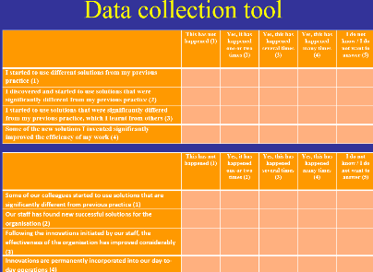
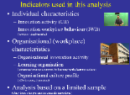
Survey tools, databases, variables
Electronic questionnaires
  Organisational (sent to all
  educational units (N ~ 18000)
  Individual – distributed by heads of units
Two rounds
  2016 – Only organisational (N ~ 5000 units)
  2018 – Two levels
    Organisational (N ~ 2000 units)
    Individual (N ~ 4000 units)
Merged databases (Innova1 + Innova2 organisational + Innova2 individual)
Variables used in this analysis
Non-representative samples

Slide 12
Data collection tool
(examples of questions)
Individual | This has not happened (1) | Yes, it has happened one or two times (2) | Yes, this has happened several times (3) | Yes, this has happened many times (4) | I do not know / I do not want to answer
I started to use different solutions from my previous practice
I discovered and started to use solutions that were significantly different from my previous practice
I started to use solutions that were significantly differed from my previous practice, which I learnt from others
Some of the new solutions I invented significantly improved the efficiency of my work
Organsiational | This has not happened (1) | Yes, it has happened one or two times (2) | Yes, this has happened several times (3) | Yes, this has happened many times (4) | I do not know / I do not want to answer
Some of our colleagues started to use solutions that are significantly different from previous practice
Our staff has found new successful solutions for the organisation
Following the new solutions initiated by our staff, the effectiveness of the organisation has improved considerably
Innovations are permanently incorporated into our day-to-day operations

Slide 13
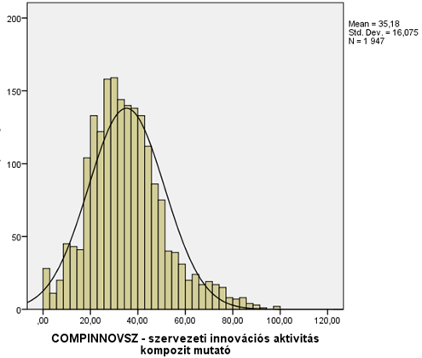
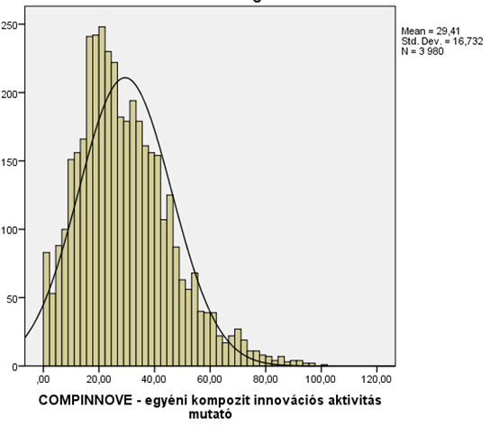
Organisational and individual composite innovation activity indicators (CII)
Organisational CII
Example of question:. „Following the new solutions initiated by our staff, the effectiveness of the organisation has improved considerably”
Individual CII
Example of question:
„Some of the new solutions I invented significantly improved the efficiency of my work”
Source: data from the Innova2 individual and organisational databases

Slide 14

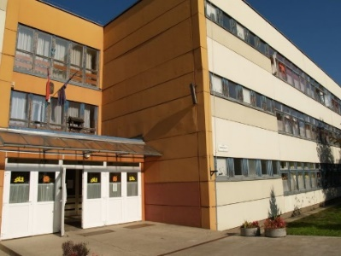
Variables used in this analysis
Individual characteristics
  Innovation activity (CII)
  Innovation workplace behaviour (IWB)
  (creative - implementer)
Organisational (workplace) characteristics
  Organisational innovation activity (CII)
  Organisational learning and culture
  (coherence/openness; support for learning/work; learning culture;
  effectiveness and dynamism)
  Organisational performance
Analysis based on a limited sample
(Only those who presented a concrete innovation!)

Slide 15
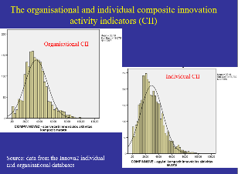
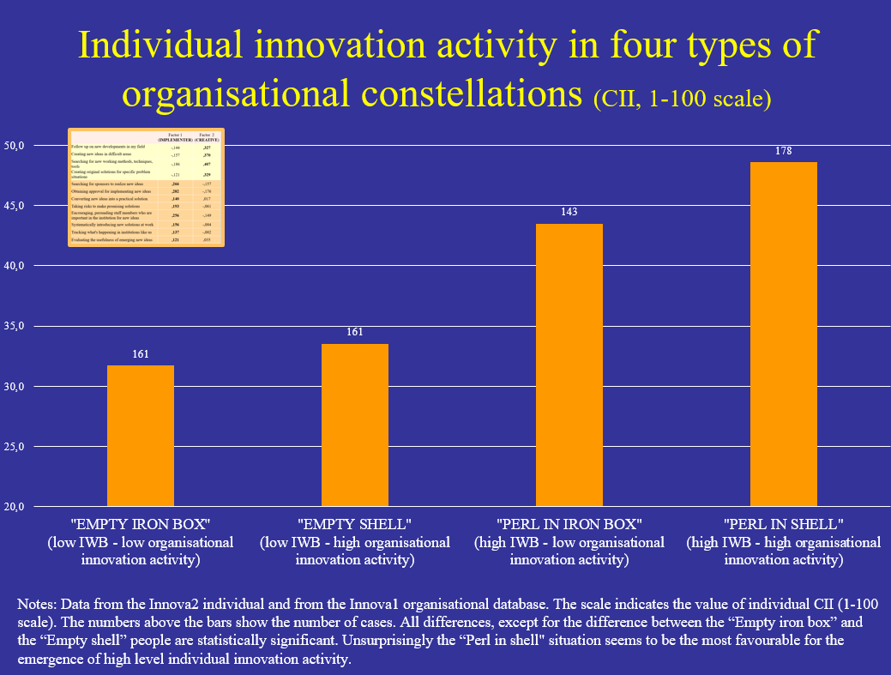
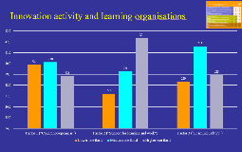
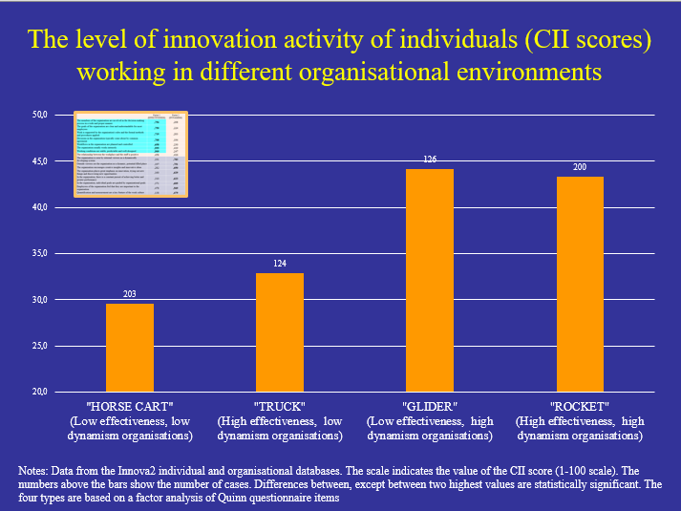
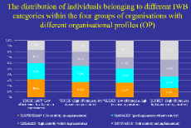
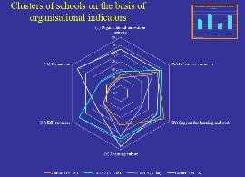
Individual innovative activity/behaviour and organisational context
The level of innovation activity (CII)
Individual innovation activity and behaviour in different organisations
  Individual CII in various kinds of
  organisational settings
  Individual CII and
  organisational learning
  Individual CII and organisational profile
  (effectiveness and dynamism)
  Four IWB types and organisational profile
  (effectiveness and dynamism)
CII & IWB in clusters of organisations

Slide 16
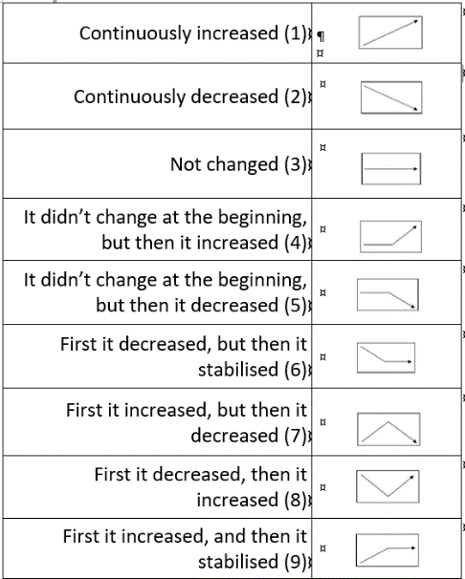
Measuring organisational performance in Innova
Basic outcomes (e.g. emotional development, graduation results, end-of-grade grades, graduates, etc.)
Other achievements (e.g. competitions, placement in the labour market, etc.)
Satisfaction of stakeholders (e.g. students, parents, maintainers, labour market, partners, etc.)
The reputation of the organisation
Organisational growth (e.g. increase in number of employees, increase in number of users, etc.)
External resources (e.g. projects, applications, grants)
Improvement of internal organisation (e.g. training of staff, cooperation within the organization, organizational processes, use of resources etc.)
Rate of dropout (e.g. early school leavers, non-degree students)
  Using internal and external data
  Internal data
    Several performance areas
    Both current status and change
    Comparison with earlier own performance and similar organisations
    Combining data from leaders and staff
  Further possibilities:
  linking internal and
  external data
  (e.g. national competence measurement
  results aggregated at school level)

Slide 17
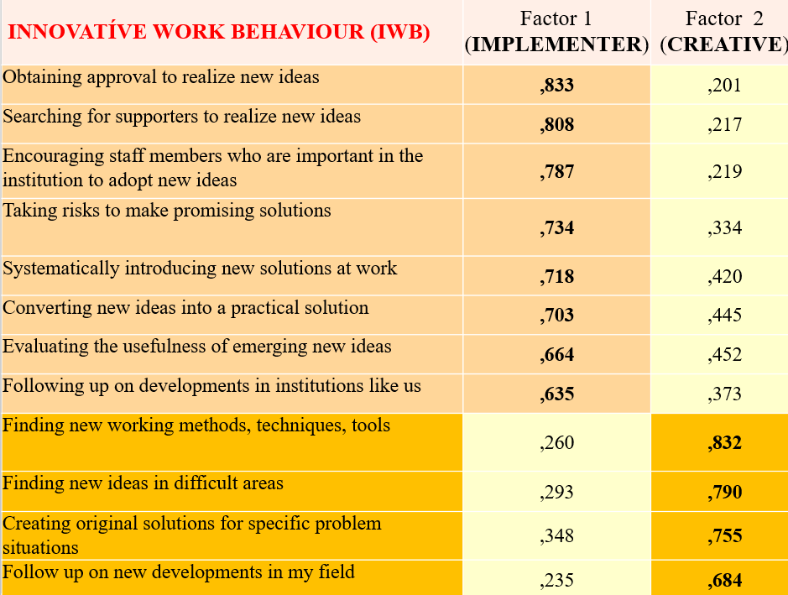


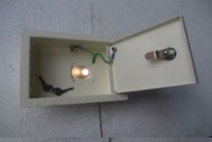
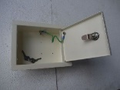
Individual innovation activity in four types of organisational constellations (CII, 1-100 scale)
Notes: Data from the Innova2 individual and from the Innova1 organisational database. The scale indicates the value of individual CII (1-100 scale). The numbers above the bars show the number of cases. All differences, except for the difference between the “Empty iron box” and the “Empty shell” people are statistically significant. Unsurprisingly the “Perl in shell" situation seems to be the most favourable for the emergence of high level individual innovation activity.

Slide 18
INNOVATÍVE WORK BEHAVIOUR (IWB) | Factor 1 (IMPLEMENTER) | Factor 2 (CREATIVE)
Obtaining approval to realize new ideas | ,833 | ,201
Searching for supporters to realize new ideas | ,808 | ,217
Encouraging staff members who are important in the institution to adopt new ideas | ,787 | ,219
Taking risks to make promising solutions | ,734 | ,334
Systematically introducing new solutions at work | ,718 | ,420
Converting new ideas into a practical solution | ,703 | ,445
Evaluating the usefulness of emerging new ideas | ,664 | ,452
Following up on developments in institutions like us | ,635 | ,373
Finding new working methods, techniques, tools | ,260 | ,832
Finding new ideas in difficult areas | ,293 | ,790
Creating original solutions for specific problem situations | ,348 | ,755
Follow up on new developments in my field | ,235 | ,684

Slide 19
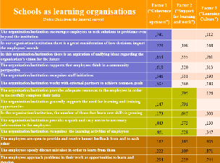
Innovation activity and learning organisations
Notes: Data from the Innova2 individual and from the Innova1 organisational database. The scale indicates the value of individual CII (1-100 scale). The numbers above the bars show the number of cases. Differences in function of "Coherence/openness" are statistically not significant. Differences between the lover and higher one thirds in "Support for learning and work" are statistically significant as well as the differences between the lover and medium high one thirds of "Learning culture".

Slide 20
Schools as learning organisations (Notes: Data from the Innova1 survey) | Factor 1 (“Coherence/ openness”) | Factor 2 (“Support for learning and work”) | Factor 3 (“Learning Culture”)
The organisation/institution encourages employees to seek solutions to problems even beyond the institution | ,741 |  | ,112
In our organisation/institution there is a great consideration of how decisions impact the employees’ morale | ,729 | ,108 | ,168
In this organisation/institution there is an aspiration of unifying ideas regarding the organisation’s vision for the future | ,653 | ,335 | ,261
The organisation/institution supports that employees think in a community perspective | ,619 | ,320 | ,313
The organisation/institution recognises staff initiatives | ,546 | ,531 | ,190
The organisation/institution works with external partners to achieve common goals | ,507 | ,386 | ,180
The organisation/institution provides adequate resources to the employees in order to successfully complete their tasks |  | ,795 | ,126
The organisation/institution generally supports the need for learning and training opportunities | ,147 | ,791
In the organisation/institution, the number of those that learn new skills is growing | ,173 | ,645 | ,300
The organisation/institution provides a quick and easy access to necessary information to the employees | ,443 | ,573 | ,130
The organisation/institution recognises the learning activities of employees | ,461 | ,528 | ,347
The employees are open to provide and receive honest feedback from and to each other | ,167 | ,163 | ,905
The employees openly discuss mistakes in order to learn from them | ,222 | ,109 | ,871
The employees approach problems in their work as opportunities to learn and develop | ,294 | ,239 | ,744

Slide 21
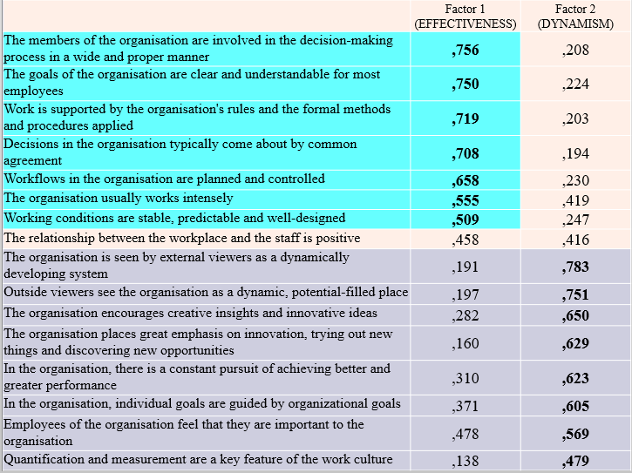
The level of innovation activity of individuals (CII scores) working in different organisational environments
Notes: Data from the Innova2 individual and organisational databases. The scale indicates the value of the CII score (1-100 scale). The numbers above the bars show the number of cases. Differences between, except between two highest values are statistically significant. The four types are based on a factor analysis of Quinn questionnaire items

Slide 22
 | Factor 1 (EFFECTIVENESS) | Factor 2 (DYNAMISM)
The members of the organisation are involved in the decision-making process in a wide and proper manner | ,756 | ,208
The goals of the organisation are clear and understandable for most employees | ,750 | ,224
Work is supported by the organisation's rules and the formal methods and procedures applied | ,719 | ,203
Decisions in the organisation typically come about by common agreement | ,708 | ,194
Workflows in the organisation are planned and controlled | ,658 | ,230
The organisation usually works intensely | ,555 | ,419
Working conditions are stable, predictable and well-designed | ,509 | ,247
The relationship between the workplace and the staff is positive | ,458 | ,416
The organisation is seen by external viewers as a dynamically developing system | ,191 | ,783
Outside viewers see the organisation as a dynamic, potential-filled place | ,197 | ,751
The organisation encourages creative insights and innovative ideas | ,282 | ,650
The organisation places great emphasis on innovation, trying out new things and discovering new opportunities | ,160 | ,629
In the organisation, there is a constant pursuit of achieving better and greater performance | ,310 | ,623
In the organisation, individual goals are guided by organizational goals | ,371 | ,605
Employees of the organisation feel that they are important to the organisation | ,478 | ,569
Quantification and measurement are a key feature of the work culture | ,138 | ,479

Slide 23
The distribution of individuals belonging to different IWB categories within the four groups of organisations with different organisational profiles (OP)
Source: Data from the Innova2 individual and organisational databases

Slide 24
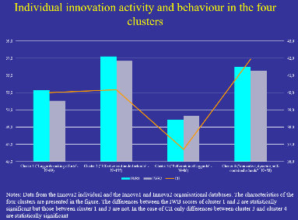
Clusters of education units on the basis of the six organisational indicators
Source: Data from the Innova1 (2a, 2b, 2c) and from the Innova2 (1, 3a, 3b) organisational databases. Only cases with data from both Innova surveys are included

Slide 25
Individual innovation activity and behaviour in the four clusters
Notes: Data from the Innova2 individual and the Innova1 and Innova2 organisational databases. The characteristics of the four clusters are presented in the figure on clusters. The differences between the IWB scores of cluster 1 and 2 are statistically significant but those between cluster 1 and 3 are not. In the case of CII only differences between cluster 3 and clusters 2 and 4 are statistically significant

Slide 26
Individual innovation behaviour and change of organisational performance
Note: individual data. Number of cases above the bars. The left hand side scale has been calculated on the basis of questions related with organisational performance as judged by individuals (1 = major deterioration; 2 = Smaller deterioration; 3 = No change; 4 = Smaller improvement; 5 = Major improvement). From the left side the difference between bar one and two is statistically not significant, between bar one and three is significant. The right hand scale is calculated on the basis of leader’s opinion . This is a 1 to 3 scale. (1 = deterioration; 2 = no change; 3 = improvement)

Slide 27
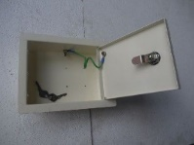


Change of organisational performance in schools belonging to four clusters (%)

