Slide 1
Synergy model. Creating innovative education environment Open innovation forum Moscow, 2018 October 15 Gábor Halász ELTE/OFI Budapest
Click on picture in blue frame!
This presentation is based on the outcomes of the research projects entitled „The emergence and diffusion of local innovations and their systemic impact in the education sector” (No. 115857)

Slide 2
Measuring innovation in the education sector
Innovation can and should be measured: innovation surveys in the education sector
Where to measure? (levels)
Organisations
Individuals
What to measure? (variables)
Activity (frequency of innovation)
Behaviour, capacity, attitudes

Slide 3
Examples of survey questions
Individual
I started to use solutions that were significantly differed from my previous practice, which I learnt from others
Some of the new solutions I invented significantly improved the efficiency of my work
Organisational
Following the innovations initiated by our staff, the effectiveness of the organisation has improved considerably
Innovations are permanently incorporated into our day-to-day operations

Slide 4
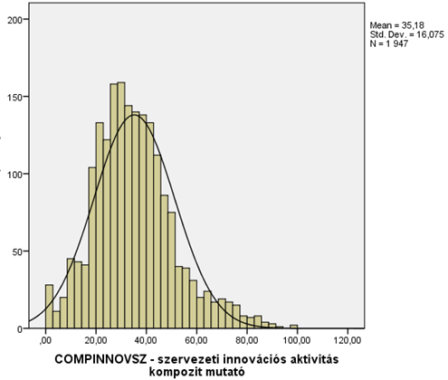
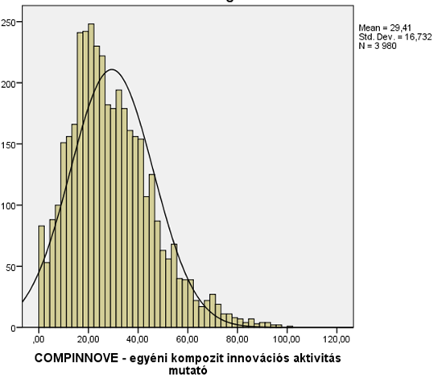
Organisational and individual innovation activity is normally distributed
Organisational innovation activity
Individual innovation activity
Source: data from the Innova2 individual and organisational databases

Slide 5
Organisational typologies
High dynamism
„GLIDERS”
„ROCKETS”
Low effectiveness
High effectiveness
„HORSECARTS”
„TRUCKS”
Low dynamism
Source: Data from the Innova2 individual and organisational databases
Notes:
5

Slide 6
Individual typologies
High implementation skills
„MANAGERS”
„INNOVATORS”
Low creativity
High creativity
„ROUTINEMEN”
„DREAMERS”
Low implementation skills
Source: Data from the Innova2 individual and organisational databases
Notes:
6

Slide 7
Combining typologies (distribution of individuals belonging to different categories within organisations with different organisational profiles)
Source: Data from the Innova2 individual and organisational databases

Slide 8
Drivers and barriers (some conclusions)
We have to think at two levels simultaneously: organisations and individuals
We have to think in types/typologies and not in averages
Organisational capacities seem to play a key role
Current regulatory frameworks allow much more opportunities than we think
„Disciplined innovators” seem to be the most successful in the school sector

Slide 9
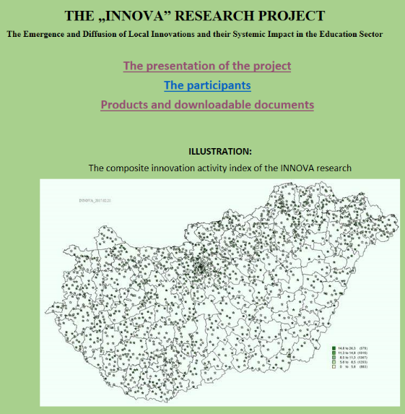
The Innova research project
„The emergence and diffusion of local innovations and their systemic impact in the education sector”
A project funded by the Hungarian National Research, Development and Innovation Office (2016-2019)

Slide 10
Thank you for your attention!
This presentation is based on the outcomes of the research projects entitled „The emergence and diffusion of local innovations and their systemic impact in the education sector” (No. 115857)

