Slide 1
Measuring innovation in education: individual behaviour and its organisational environment
Institute of Education, National Research University Higher School of Economics
Moscow, 2018 October 16
Gábor Halász
ELTE/OFI Budapest
Click on pictures in orange frame!
This presentation is based on the outcomes of the research projects entitled „The emergence and diffusion of local innovations and their systemic impact in the education sector” (No. 115857)

Slide 2
General background
Innovation is increasingly seen
as a major source of improving
effectiveness in the public
sector, including education
Challenges:
  How to adapt national innovation
  strategies to the specific
  education sector context
  How to measure innovation
  in the education sector

Slide 3
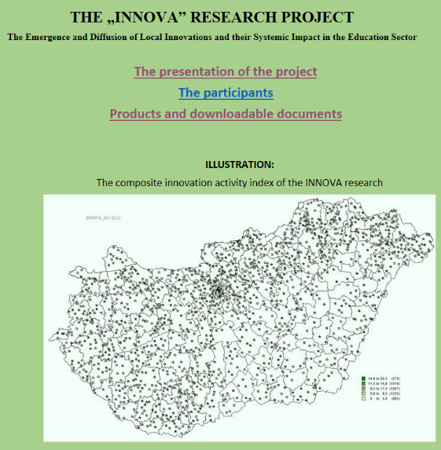
The Innova research project
„The emergence and
diffusion of local
innovations and their
systemic impact in the
education sector”
A project funded by the
Hungarian National Research,
Development and Innovation Office
(2016-2019)

Slide 4
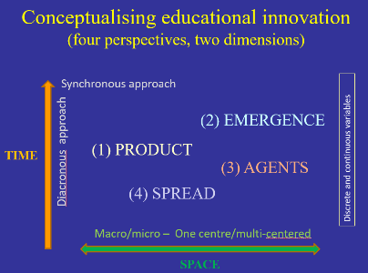
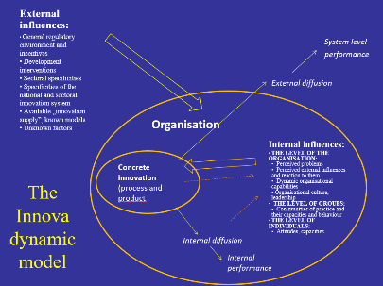
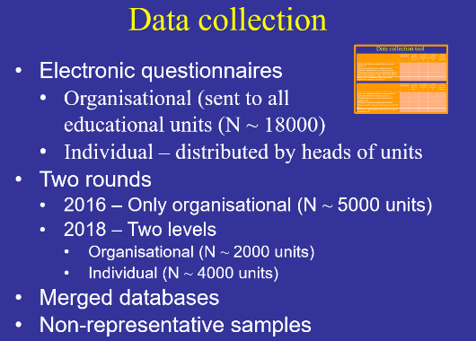
Conceptualisation and survey tools
Creating an analytical
framework (defining relevant
perspectives and dimensions)
Designing theoretical models
(both static and dynamic)
Survey tools and
rounds of data collection
  All subsystems (a major challenge!)
  Organisational and individual level
  General processes and specific innovations
  Contextual variables

Slide 5

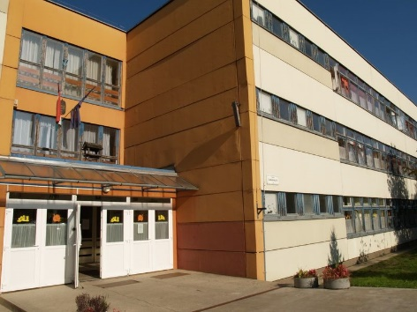
Indicators used in this analysis
Individual characteristics
  Innovation activity (CII)
  Innovation workplace behaviour (IWB)
  (creative - implementer)
Organisational (workplace) characteristics
  Organisational innovation activity
  Learning organisation
  (coherence/openness; support for learning/work; learning culture)
  Organisational culture profile
  (effectiveness, dynamism)
Analysis based on a limited sample
(Only those who presented a concrete innovation!)

Slide 6
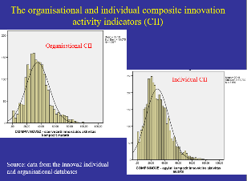
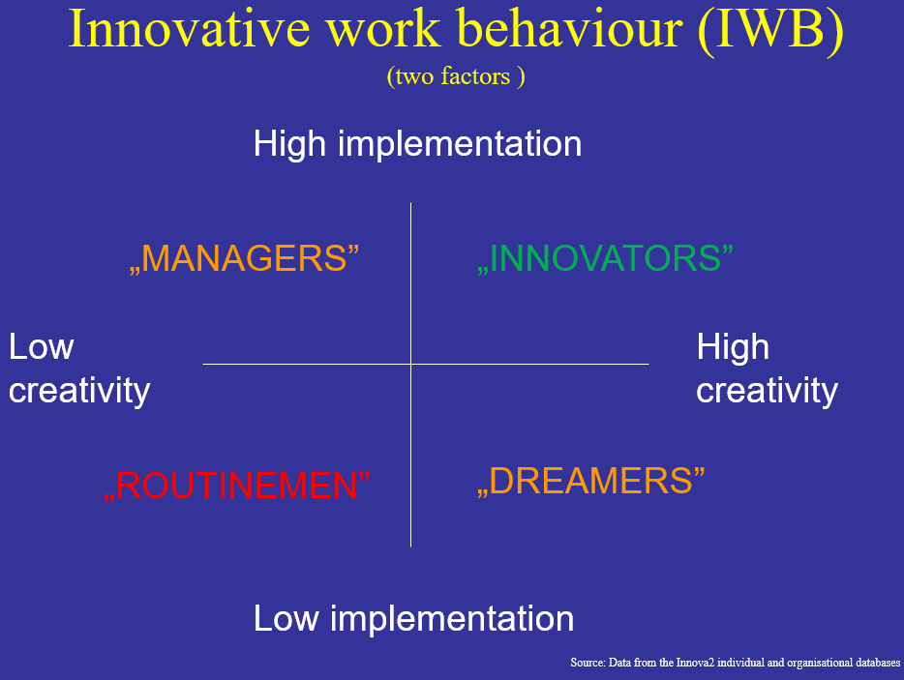
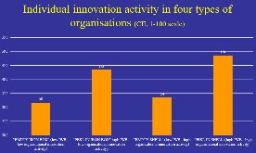
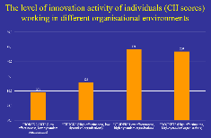
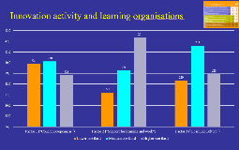
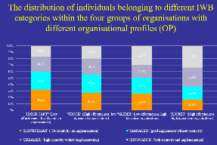
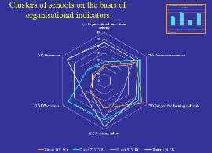
Individual behaviour and organisational context
Innovation activity + behaviour
Individual innovation activity in different organisations
  Individuals and organisations (4 types)
  Organisational profile (Quinn items)
  Organisational learning (DLOQ)
Innovation behaviour in different organisations (Quinn profile)
Individual innovation and behaviour in different clusters of organisations

Slide 7
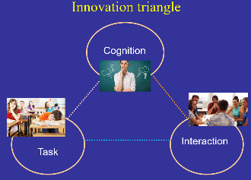
Qualitative case studies
Educational organisations demonstrating high level innovation activity typically pursue „disciplined innovation”
  They exploit all opportunities provided by
  the existing regulatory frameworks
  They are continuously expanding boundaries
All examined schools are dynamic innovation ecosystems full of innovation processes
The dynamics of innovation in these organisations can be described by the „innovation triangle” model.

Slide 8
Some conclusions
Innovation in the education sector is measurable
There is a high level variance in the innovation activity of both individuals (teachers) and organisations (schools)
The creation of individual and organisational level innovation indicators makes it possible the analysis of the relationship between workplace characteristics and the innovation activity/behaviour of individuals
There is a rather strong relationship between the organisational characteristics of workplaces (educational units) and the innovation activity/behaviour of their employees (teachers)

Slide 9
Thank you for your attention!
The details of this presentation can be found in the paper „Measuring innovation in education with a special focus on the impact of organisational characteristics”
(prepared for the 2018 ECER conference, Bolzano).
Requests: halaszg@helka.iif.hu).
This presentation is based on the outcomes of the research projects entitled „The emergence and diffusion of local innovations and their systemic impact in the education sector” (No. 115857)

Slide 10

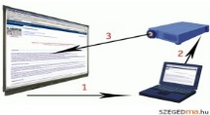

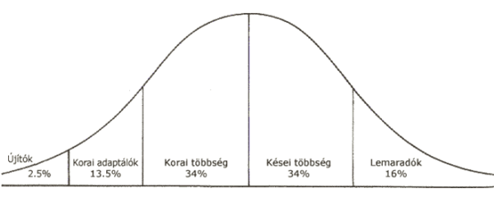
Conceptualising educational innovation
(four perspectives, two dimensions)
(Download the detailed model from here)
Synchronous approach
(2) EMERGENCE
(process)
Diacronous approach
(1) PRODUCT
Discrete and continuous variables
TIME
(3) AGENTS
(4) SPREAD
(process)
Macro/micro – One centre/multi-centred
SPACE

Slide 11
External influences:
General regulatory environment and incentives
Development interventions
Sectoral specificities
Specificities of the national and sectoral innovation system
Available „innovation supply”, known models
Unknown factors
System level
performance
External diffusion
Organisation
Internal influences:
THE LEVEL OF THE ORGANISATION:
  Perceived problems
  Perceived external influences and reaction to them
  Dynamic organisational capabilities
  Organisational culture, leadership
THE LEVEL OF GROUPS:
Communities of practice and their capacities and behaviour
THE LEVEL OF INDIVIDUALS:
Activity, behaviour
Concrete innovation
(process and product
The Innova dynamic model
Internal diffusion
Internal
performance

Slide 12
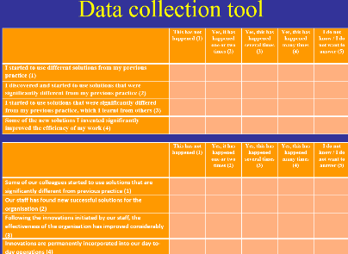
Survey tools and data collection
Electronic questionnaires
  Organisational (sent to all
  educational units (N ~ 18000)
  Individual – distributed by heads of units
Two rounds
  2016 – Only organisational (N ~ 5000 units)
  2018 – Two levels
    Organisational (N ~ 2000 units)
    Individual (N ~ 4000 units)
Merged databases (Innova1 + Innova2 organisational + Innova2 individual)
Non-representative samples
Case studies (N=12) and face-to-face interviews (N=100)

Slide 13
Data collection tool
(examples of questions)
Individual | This has not happened (1) | Yes, it has happened one or two times (2) | Yes, this has happened several times (3) | Yes, this has happened many times (4) | I do not know / I do not want to answer
I started to use different solutions from my previous practice
I discovered and started to use solutions that were significantly different from my previous practice
I started to use solutions that were significantly differed from my previous practice, which I learnt from others
Some of the new solutions I invented significantly improved the efficiency of my work
Organisational | This has not happened (1) | Yes, it has happened one or two times (2) | Yes, this has happened several times (3) | Yes, this has happened many times (4) | I do not know / I do not want to answer
Some of our colleagues started to use solutions that are significantly different from previous practice
Our staff has found new successful solutions for the organisation
Following the innovations initiated by our staff, the effectiveness of the organisation has improved considerably
Innovations are permanently incorporated into our day-to-day operations

Slide 14
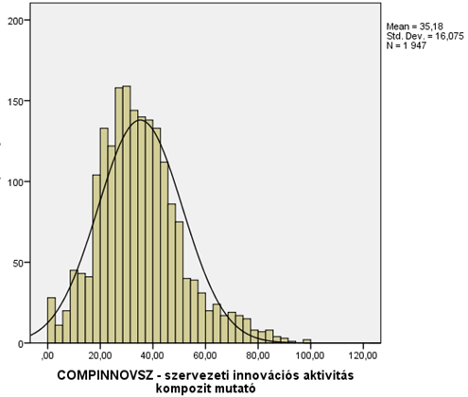
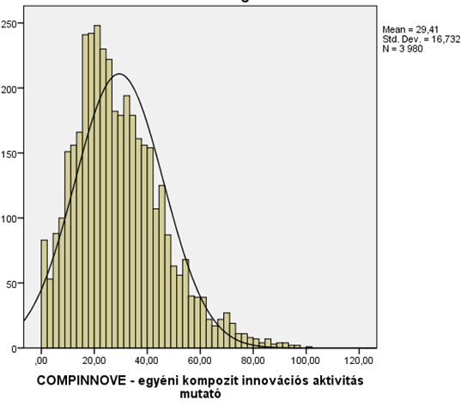
The organisational and individual composite innovation activity indicators (CII)
Organisational CII
Individual CII
Source: data from the Innova2 individual and organisational databases

Slide 15
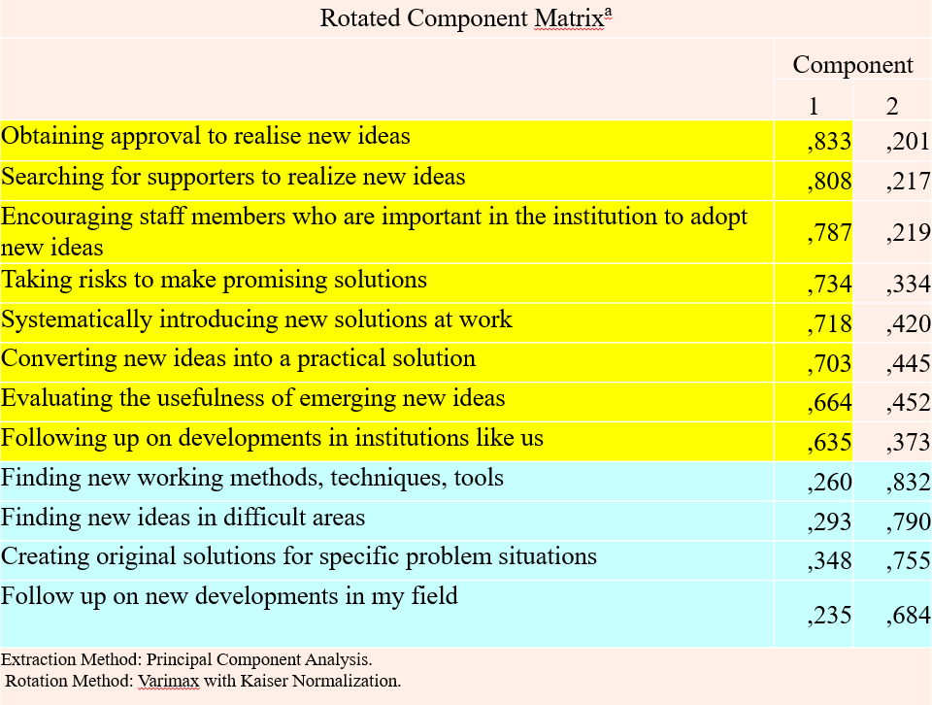
Innovative work behaviour (IWB)
(two factors)
High implementation
„MANAGERS”
„INNOVATORS”
Low creativity
High creativity
„ROUTINEMEN”
„DREAMERS”
Low implementation
Source: Data from the Innova2 individual and organisational databases
Notes:
15

Slide 16
Rotated Component Matrixª
 | Component
 | 1 | 2
Obtaining approval to realise new ideas | ,833 | ,201
Searching for supporters to realize new ideas | ,808 | ,217
Encouraging staff members who are important in the institution to adopt new ideas | ,787 | ,219
Taking risks to make promising solutions | ,734 | ,334
Systematically introducing new solutions at work | ,718 | ,420
Converting new ideas into a practical solution | ,703 | ,445
Evaluating the usefulness of emerging new ideas | ,664 | ,452
Following up on developments in institutions like us | ,635 | ,373
Finding new working methods, techniques, tools | ,260 | ,832
Finding new ideas in difficult areas | ,293 | ,790
Creating original solutions for specific problem situations | ,348 | ,755
Follow up on new developments in my field | ,235 | ,684
Extraction Method: Principal Component Analysis. Rotation Method: Varimax with Kaiser Normalization.

Slide 17
Individual innovation activity in four types of organisations (CII, 1-100 scale)
Notes: Data from the Innova2 individual and from the Innova1 organisational database. The scale indicates the value of individual CII (1-100 scale). The numbers above the bars show the number of cases. All differences, except for the difference between the “Empty iron box” and the “Empty shell” people are statistically significant. Unsurprisingly the “Perl in shell" situation seems to be the most favourable for the emergence of high level individual innovation activity.

Slide 18
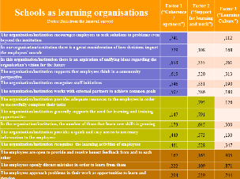
Innovation activity and learning organisations
Notes: Data from the Innova2 individual and from the Innova1 organisational database. The scale indicates the value of individual CII (1-100 scale). The numbers above the bars show the number of cases. Differences in function of "Coherence/openness" are statistically not significant. Differences between the lover and higher one thirds in "Support for learning and work" are statistically significant as well as the differences between the lover and medium high one thirds of "Learning culture".

Slide 19
Schools as learning organisations (Notes: Data from the Innova1 survey) | Factor 1 (“Coherence/ openness”) | Factor 2 (“Support for learning and work”) | Factor 3 (“Learning Culture”)
The organisation/institution encourages employees to seek solutions to problems even beyond the institution | ,741 |  | ,112
In our organisation/institution there is a great consideration of how decisions impact the employees’ morale | ,729 | ,108 | ,168
In this organisation/institution there is an aspiration of unifying ideas regarding the organisation’s vision for the future | ,653 | ,335 | ,261
The organisation/institution supports that employees think in a community perspective | ,619 | ,320 | ,313
The organisation/institution recognises staff initiatives | ,546 | ,531 | ,190
The organisation/institution works with external partners to achieve common goals | ,507 | ,386 | ,180
The organisation/institution provides adequate resources to the employees in order to successfully complete their tasks |  | ,795 | ,126
The organisation/institution generally supports the need for learning and training opportunities | ,147 | ,791
In the organisation/institution, the number of those that learn new skills is growing | ,173 | ,645 | ,300
The organisation/institution provides a quick and easy access to necessary information to the employees | ,443 | ,573 | ,130
The organisation/institution recognises the learning activities of employees | ,461 | ,528 | ,347
The employees are open to provide and receive honest feedback from and to each other | ,167 | ,163 | ,905
The employees openly discuss mistakes in order to learn from them | ,222 | ,109 | ,871
The employees approach problems in their work as opportunities to learn and develop | ,294 | ,239 | ,744

Slide 20
The level of innovation activity of individuals (CII scores) working in different organisational environments
Notes: Data from the Innova2 individual and organisational databases. The scale indicates the value of the CII score (1-100 scale). The numbers above the bars show the number of cases. Differences between, except between two highest values are statistically significant. The four types are based on a factor analysis of Quinn questionnaire items

Slide 21
The distribution of individuals belonging to different IWB categories within the four groups of organisations with different organisational profiles (OP)
Source: Data from the Innova2 individual and organisational databases

Slide 22
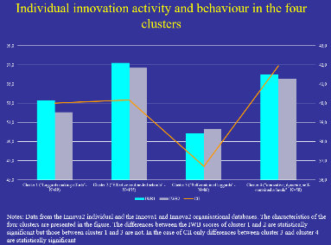
Clusters of education units on the basis of the six organisational indicators
Source: Data from the Innova1 (2a, 2b, 2c) and from the Innova2 (1, 3a, 3b) organisational databases. Only cases with data from both Innova surveys are included

Slide 23
Individual innovation activity and behaviour in the four clusters
Notes: Data from the Innova2 individual and the Innova1 and Innova2 organisational databases. The characteristics of the four clusters are presented in the figure on clusters. The differences between the IWB scores of cluster 1 and 2 are statistically significant but those between cluster 1 and 3 are not. In the case of CII only differences between cluster 3 and clusters 2 and 4 are statistically significant

Slide 24



Innovation triangle
Cognition
Interaction
Task

