Slide 1
Survey of innovation in education in Hungary
OECD conference on
“Innovation in education :
What has changed in the classroom in the past decade?”
Paris, 28 January 2019
Gábor Halász
ELTE/OFI Budapest
Click on pictures in orange frame!
This presentation is based on the outcomes of the research projects entitled „The emergence and diffusion of local innovations and their systemic impact in the education sector” (No. 115857)

Slide 2

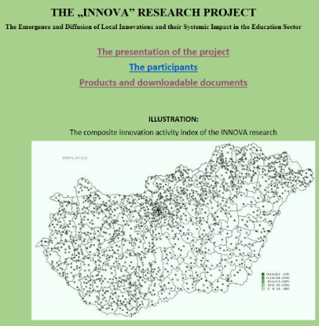
Background and context
25 years of innovation oriented policies in school education (1985-2010)
National strategy proposals for education sector innovation
The ImpAla research project
(the impact of EU funded education development programs supporting innovation)
The Innova research project
(the emergence and diffusion of local
innovations in the education sectors - ongoing)

Slide 3
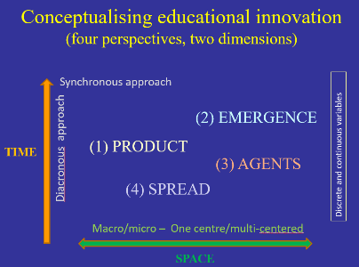
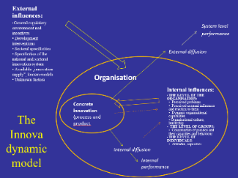
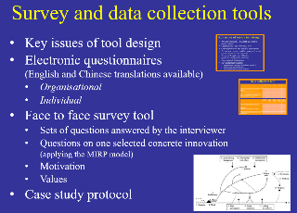
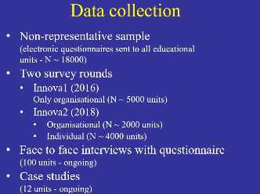
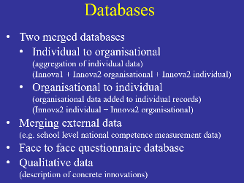
Conceptualisation and survey tools
Creating an analytical
framework
(defining relevant
perspectives and dimensions)
Designing theoretical models
(both static and dynamic)
Survey tools
Data collection
Databases

Slide 4
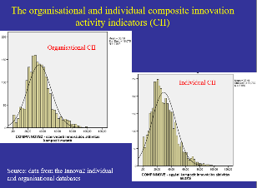
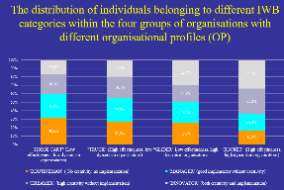
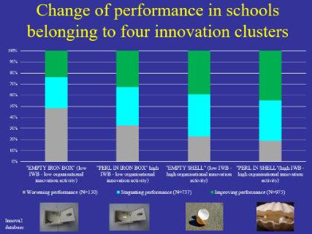
Some illustrative examples of outcomes
Creating composite innovation indicators
Normal distribution of
innovation activity
The relationship between individual innovation behaviour/activity and organisational characteristics
(causes of innovation?)
The relationship between innovation behaviour/activity and performance
(effects of innovation?)

Slide 5
Some conclusions
Innovation activity in the education sector is measurable
There is a high level variance in the innovation activity of both individuals and organisations (schools, university departments)
The creation of individual and organisational level innovation indicators makes it possible
  the analysis of relationships between workplace characteristics and innovation activity/behaviour
  the analysis of relationships between innovation activity and performance
The Hungarian education innovation survey shows significant connections between innovation activity and other factors

Slide 6
The use of results
Supporting the national education sector innovation strategy
Supporting the design of national education development programs
Developing innovation management skills in leadership training
Supporting organisational development interventions
(diagnostic tool)
Advancing theoretical knowledge on innovation processes

Slide 7
Thank you for your attention!
This presentation is based on the outcomes of the research projects entitled „The emergence and diffusion of local innovations and their systemic impact in the education sector” (No. 115857)

Slide 8

National Education Sector Innovation Strategy proposals
2011: NOIR
  Part of an EU funded
  development project
  Simulating the OECD
  education research surveys
  Focus on sectoral innovation system
2015: NOIR+
  Part of a national policy process
  Focus on knowledge management
2019: DigiNOIR
  Part of the national education digitalisation strategy implementation
  Ongoing project

Slide 9

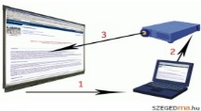

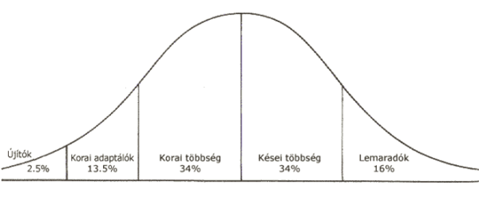
Conceptualising educational innovation
(four perspectives, two dimensions)
(Download the detailed model from here)
Synchronous approach
(2) EMERGENCE
(process)
Diacronous approach
(1) PRODUCT
Discrete and continuous variables
TIME
(3) AGENTS
(4) SPREAD
(process)
Macro/micro – One centre/multi-centred
SPACE

Slide 10
External influences:
General regulatory environment and incentives
Development interventions
Sectoral specificities
Specificities of the national and sectoral innovation system
Available „innovation supply”, known models
Unknown factors
System level
performance
External diffusion
Organisation
Internal influences:
THE LEVEL OF THE ORGANISATION:
  Perceived problems
  Perceived external influences and reaction to them
  Dynamic organisational capabilities
  Organisational culture, leadership
THE LEVEL OF GROUPS:
Communities of practice and their capacities and behaviour
THE LEVEL OF INDIVIDUALS:
Activity, behaviour
Concrete innovation
(process and product
The Innova dynamic model
Internal diffusion
Internal
performance

Slide 11
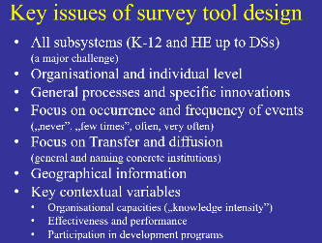
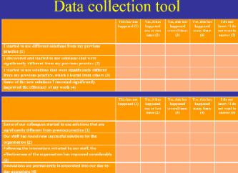
Survey and data collection tools
Key issues of tool design
Electronic questionnaires
(English and Chinese translations available)
  Organisational
  Individual
Face to face survey tool
  Sets of questions answered by the interviewer
  Questions on one selected concrete innovation
  (applying the MIRP model)
  Motivation
  Values
Case study protocol
Van de Ven, Andrew H. – Angle, Harold L. – Poole, Marshall Scott (2000): Research on the Management of Innovation. The Minnesota Studies. Oxford University Press

Slide 12
Key issues and solutions of survey tool design/1
  A major challenge: using the same tool
  in all subsystems
  (from kindergartens to doctoral schools)
  Collecting both organisational and individual level data and connecting them
  Focusing on both general processes and specific concrete innovations
  Focusing on occurrence and frequency of events (less on attitudes)
  („never”, „few times”, often, very often)
  Avoiding the use of the term „innovation”

Slide 13
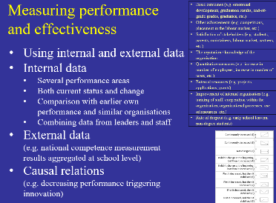
Key issues and solutions of survey tool design/2
  Collecting data on transfer and diffusion
    general features of adaptation and sharing
    naming concrete institutions and identifying innovation sharing networks
  Gathering geographical information
  Defining key contextual variables
    Supporting and hindering factors
    Organisational capacities
    („knowledge intensity”)
    Performance and effectiveness
    Prior participation in development programs
    Disciplinary areas

Slide 14
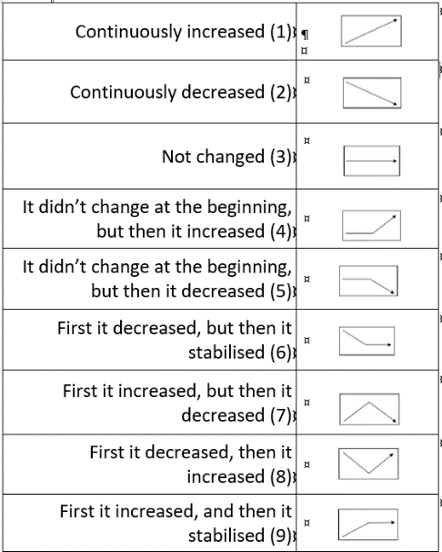
Measuring performance and effectiveness
Basic outcomes (e.g. emotional development, graduation results, end-of-grade grades, graduates, etc.)
Other achievements (e.g. competitions, placement in the labour market, etc.)
Satisfaction of stakeholders (e.g. students, parents, maintainers, labour market, partners, etc.)
The reputation of the organisation
Organisational growth (e.g. increase in number of employees, increase in number of users, etc.)
External resources (e.g. projects, applications, grants)
Improvement of internal organisation (e.g. training of staff, cooperation within the organization, organizational processes, use of resources etc.)
Rate of dropout (e.g. early school leavers, non-degree students)
  Using internal and external data
  Internal data
    Several performance areas
    Both current status and change
    Comparison with earlier own performance and similar organisations
    Combining data from leaders and staff
  External data
  (e.g. national competence measurement
  results aggregated at school level)
  Causal relations
  (e.g. decreasing performance triggering innovation)

Slide 15
Data collection
Non-representative sample
(electronic questionnaires sent to all educational
units - N ~ 18000)
Two survey rounds
  Innova1 (2016)
  Only organisational (N ~ 5000 units)
  Innova2 (2018)
    Organisational (N ~ 2000 units)
    Individual (N ~ 4000 units)
Face to face interviews with questionnaire
(100 units - ongoing)
Case studies
(12 units - ongoing)

Slide 16
Data collection tool
(examples of questions)
Organsiational | This has not happened (1) | Yes, it has happened one or two times (2) | Yes, this has happened several times (3) | Yes, this has happened many times (4) | I do not know / I do not want to answer
Some of our colleagues started to use solutions that are significantly different from previous practice
Our staff has found new successful solutions for the organisation
Following the innovations initiated by our staff, the effectiveness of the organisation has improved considerably
Innovations are permanently incorporated into our day-to-day operations
Individual | This has not happened (1) | Yes, it has happened one or two times (2) | Yes, this has happened several times (3) | Yes, this has happened many times (4) | I do not know / I do not want to answer
I started to use different solutions from my previous practice
I discovered and started to use solutions that were significantly different from my previous practice
I started to use solutions that were significantly differed from my previous practice, which I learnt from others
Some of the new solutions I invented significantly improved the efficiency of my work

Slide 17
Databases
Two merged databases
  Individual to organisational
  (aggregation of individual data)
  (Innova1 + Innova2 organisational + Innova2 individual)
  Organisational to individual
  (organisational data added to individual records)
  (Innova2 individual + Innova2 organisational)
Merging external data
(e.g. school level national competence measurement data)
Face to face questionnaire database
Qualitative data
(description of concrete innovations)

Slide 18
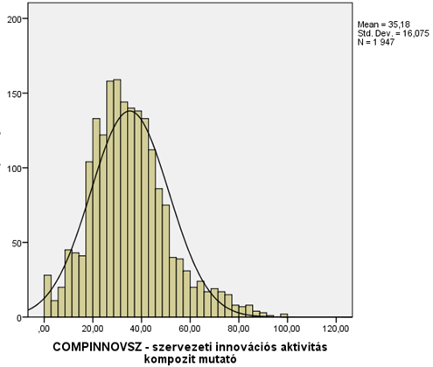
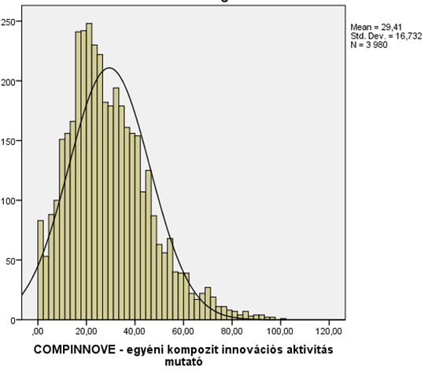
Organisational and individual composite innovation activity indicators (CII)
Organisational CII
Individual CII
Source: data from the Innova2 individual and organisational databases

Slide 19
The distribution of individuals belonging to different IWB categories within the four groups of organisations with different organisational profiles (OP)
Source: Data from the Innova2 individual and organisational databases

Slide 20


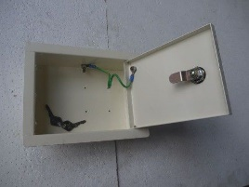
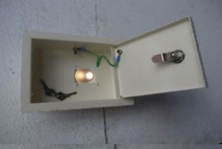
Change of performance in schools belonging to four clusters (%)

