Slide 1
Teacher learning and innovation
The 2nd Belt and Road Education Dialogue
Beijing, 2018 November 24-26
Gábor Halász
ELTE/OFI Budapest
Click on pictures in orange frame!
This presentation is based on the outcomes of the research projects entitled „The emergence and diffusion of local innovations and their systemic impact in the education sector” (No. 115857)

Slide 2
Our departure points
We see innovation as a
major source of improving
effectiveness in the public
sector, including education
We see learning as a key
component of innovation,
especially when it is embedded into daily work practices

Slide 3
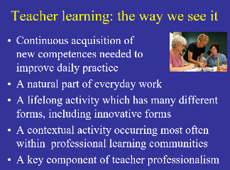
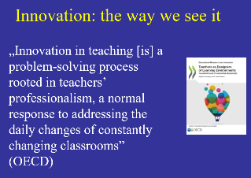
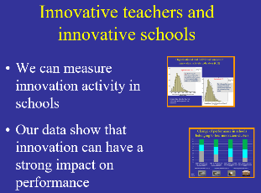
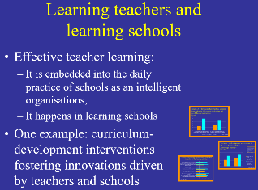
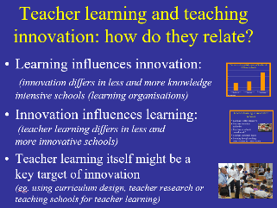
Our questions
How do we see teacher learning?
How do we see innovation?
What do we know about innovation in education?
What do we know about teacher learning?
How do they relate?

Slide 4
Some conclusions
If we foster innovation in education we have to strengthen teacher learning
We have to understand better how teachers learn when doing non-routine work
We need innovation also in the way our teachers learn

Slide 5
Thank you for your attention!
Some details of this presentation can be found in the paper „Teacher Learning and Innovation: the Case of Hungary” (prepared for the „Belt & Road Education Dialogue” program).
Requests: halaszg@helka.iif.hu).
This presentation is based on the outcomes of the research projects entitled „The emergence and diffusion of local innovations and their systemic impact in the education sector” (No. 115857)

Slide 6

Teacher learning: the way we see it
Continuous acquisition of
new competences needed to
improve daily practice
A natural part of everyday work
A lifelong activity which has many different forms, including innovative forms
A contextual activity occurring most often within professional learning communities
A key component of teacher professionalism

Slide 7
Innovation: the way we see it
„Innovation in teaching [is] a problem-solving process rooted in teachers’ professionalism, a normal response to addressing the daily changes of constantly changing classrooms”
(OECD)

Slide 8
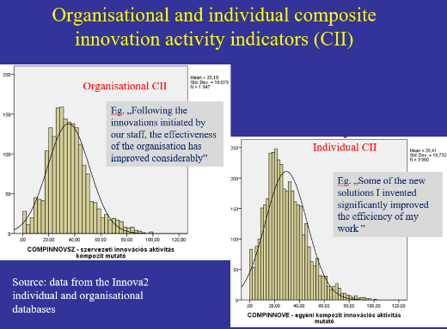
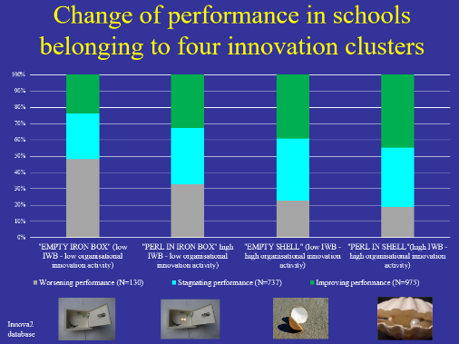
Innovative teachers and innovative schools
We can measure the innovation activity of teachers and schools
Our data show that innovation can have a strong impact on performance

Slide 9
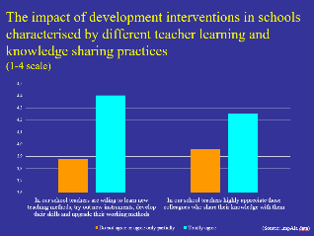
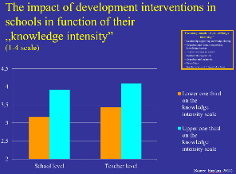
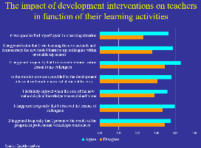
Learning teachers and learning schools
Effective teacher learning:
  It is embedded into the daily practice of schools as an intelligent organisations,
  It needs learning schools
One example:
curriculum-development interventions fostering innovations driven by teachers and schools

Slide 10
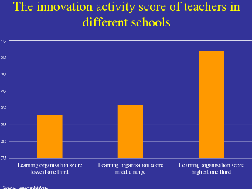
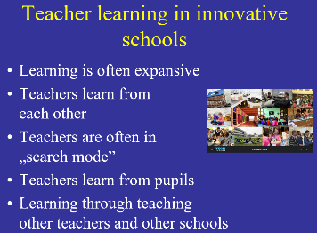
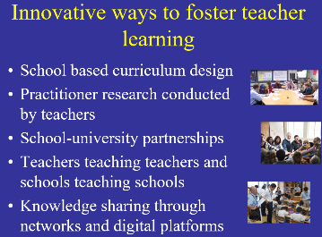
Teacher learning and teaching innovation: how do they relate?
Learning influences innovation:
(innovation differs in less and more knowledge intensive schools (learning organisations)
Innovation influences learning:
(teacher learning differs in less and
more innovative schools)
Teacher learning itself might
be a key target of innovation
(e.g.. using curriculum design, teacher research or teaching schools for teacher learning)

Slide 11




Innovative ways to foster teacher learning
School based curriculum design
Practitioner research conducted by teachers
School-university partnerships
Teachers teaching teachers and schools teaching schools
Knowledge sharing through networks and digital platforms

Slide 12
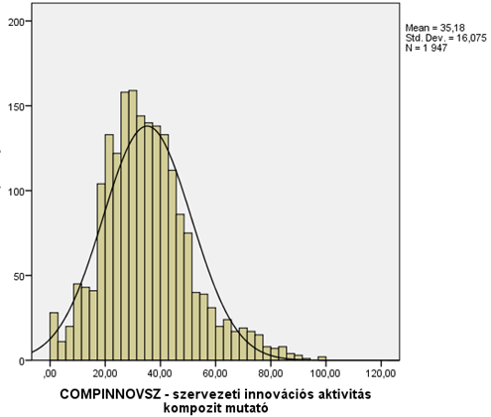
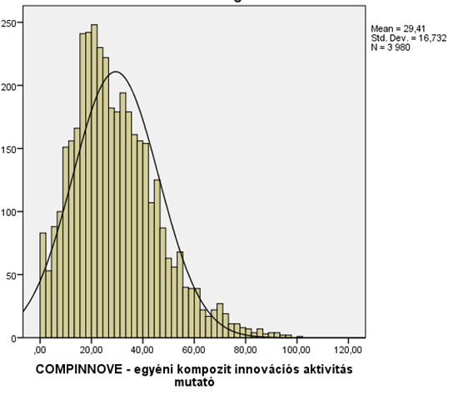
Organisational and individual composite innovation activity indicators (CII)
Organisational CII
Eg. „Following the innovations initiated by our staff, the effectiveness of the organisation has improved considerably”
Individual CII
Eg. „Some of the new solutions I invented significantly improved the efficiency of my work ”
Source: data from the Innova2 individual and organisational databases

Slide 13


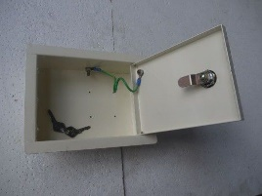

Change of performance in schools belonging to four innovation clusters
Innova2 database; IWB = Innovative Work Behaviour

Slide 14
The impact of development interventions in schools characterised by different teacher learning and knowledge sharing practices
(Source: ImpAla data)

Slide 15
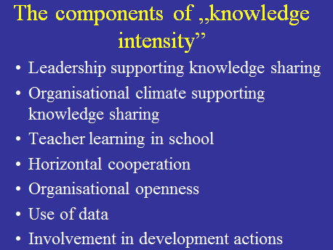
The impact of development interventions in schools in function of their
„knowledge intensity”
(Source: Fazekas, 2014)

Slide 16
The innovation activity score of teachers in different schools
Source: Imnova database

Slide 17
The components of „knowledge intensity”
Leadership supporting knowledge sharing
Organisational climate supporting knowledge sharing
Teacher learning in school
Horizontal cooperation
Organisational openness
Use of data
Involvement in development actions

Slide 18
The impact of development interventions on teachers in function of their learning activities
Source: ImpAla database

Slide 19
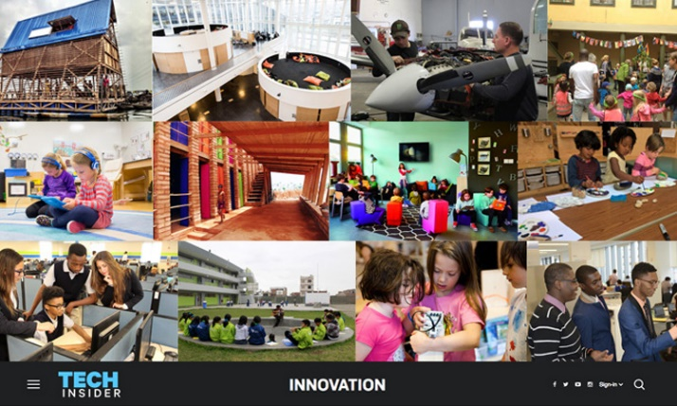
Teacher learning in innovative schools
Learning is often expansive
Teachers learn from
each other
Teachers are often in
„search mode”
Teachers learn from pupils
Learning through teaching other teachers and other schools

Slide 20
The innovation activity score of teachers taking part in various professional learning and teaching activities
Source: Imnova database

Slide 21
The proportion of teachers who observe the class of another teacher in grade 4 (2007-2015)
Source: IEA data. OECD Education Innovation Strategy project leader’s presentation (2017.11.16)

