Slide 1


The Key to the Teaching Profession:
How Professional Identity Develops
ATEE 2025 Annual Conference – Dublin, 26-29 August 2025
Sándor Lénárd, PhD., Habil. Associate Professor
Nóra Rapos, Dóra Czirfusz, Orsolya Horváth, Ildikó Vörös
ELTE Faculty of Education and Psychology
School Organization, Teacher Education and Professional Learning Research Group
The research was supported by the National Research, Development and Innovation Fund (DOKK).
Notes:
Good afternoon, dear colleagues. My name is Sándor Lénárd, from Eötvös Loránd University, in Budapest, Hungary.
In this talk, I will speak about how professional identity develops in teacher education.
In Hungary, two years ago, a new practice was introduced: a three-semester-long career socialisation course.
I will show how this course supports students’ professional development, and why it matters for teacher education.

Slide 2
.relevance of the research
The development of a professional identity is a crucial aspect of becoming a teacher.
This identity is vital for teacher retention and reducing attrition (Gaziel, 1995; Hong, 2010).
Teachers who adopt a reflective attitude toward their identity are able to:
Manage professional tensions more effectively (Hong, Greene, & Lowery, 2017; Pillen, den Brok, & Beijaard, 2013).
Exhibit higher emotional involvement and commitment (Rots et al., 2010; Zembylas, 2003).
Respond constructively to educational changes (Nias, 1989).
A well-developed professional identity also supports the formation of a teaching philosophy (Mockler, 2011) and enhances professional decision-making (Beijaard, Meijer, & Verloop, 2004).
Notes:
Professional identity is very important in becoming a teacher.
It is not only about choosing the career, but also about staying in the profession and avoiding dropout.
Teachers who reflect on their own identity can handle problems better, and they are more committed to their work.
A strong identity also helps them to develop their own teaching style and make good everyday decisions.

Slide 3
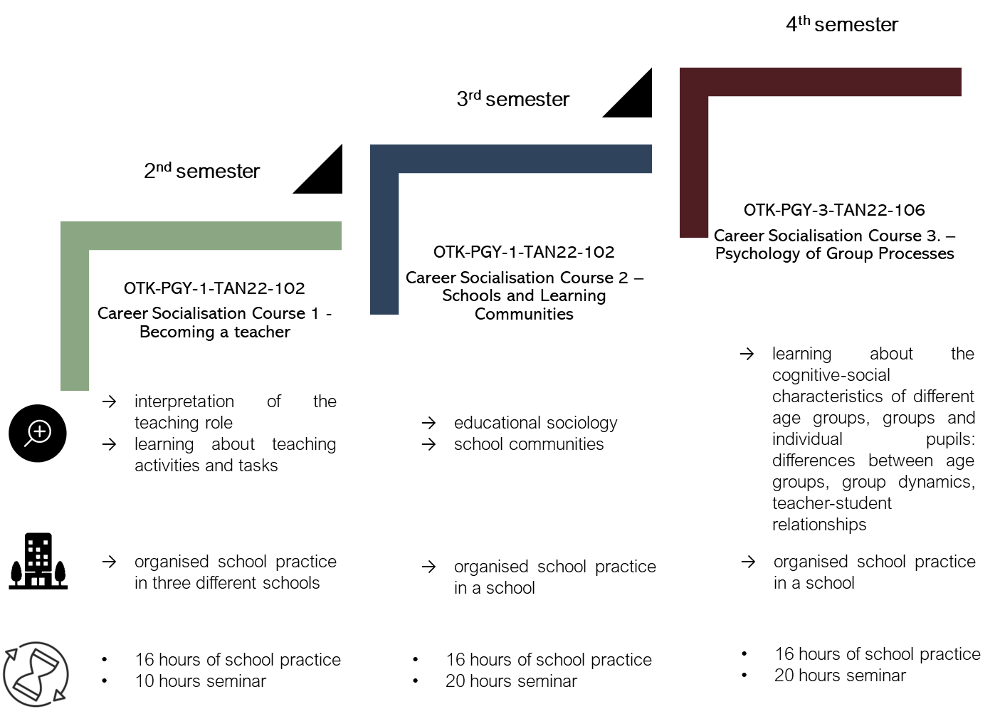

.Context of the research: career socialisation courses in hungary
Purpose:
To provide students with early experience in a school environment.
To explore various institutions and teaching practices.
To recognize the characteristics of different age groups and classes.
Tasks:
Observe classroom activities. Engage in conversations with students.
Conduct interviews.
Organize group leisure activities for students.
Notes:
This practice is built on three connected semesters.
The goal is that students get school experience already at the start of their studies.
They visit different schools, see different teaching styles, and learn about working with different age groups.
Their tasks are to observe lessons, talk with students and teachers, make short interviews, and organise small group activities.

Slide 4
1. Research: Initiative of the Association of Teacher Educators
Research design:
Collaborative research project: inter-institutional research group
Shared research tool: tailored with institution-specific questions
Distinct institutional studies: enhancing research at each institution
Topics / Focus areas:
Study induction practices (longitudinal study – comparing entry and exit questionnaires with the same students or final-year students; several data points: questionnaire, focus group)
Developing of professional cooperation between university lecturers and school teachers (questionnaire, interview, case study, etc.)
Notes:
This research is part of a national project in Hungary.
Several universities work together in one research group.
We use the same questionnaire everywhere, but each university can also add their own questions.
We follow students during their studies to see how their views and skills change.
We also study the cooperation between university lecturers and school teachers, with questionnaires, interviews, and case studies.

Slide 5
2. Aims and research questions
  For students who completed the entry questionnaire, we ask:
  What defines the professional identity of student teachers before they begin their induction practice?
  What factors contribute to their career motivation?
  How do they perceive their teacher self-image and self-efficacy?
  How do they interpret the role of a teacher?
  What is the relationship between these three factors and the student's prior professional experience or gender?
Notes:
At the start of the practice, students filled in a questionnaire. We wanted to know about their professional identity before real teaching.
We asked what motivates them to become teachers, how they see themselves, and how confident they feel in their teaching skills.
We also asked how they understand the role of a teacher, and what they see as the main tasks in the classroom.
Finally, we looked at how these answers depend on gender or previous work experience.

Slide 6
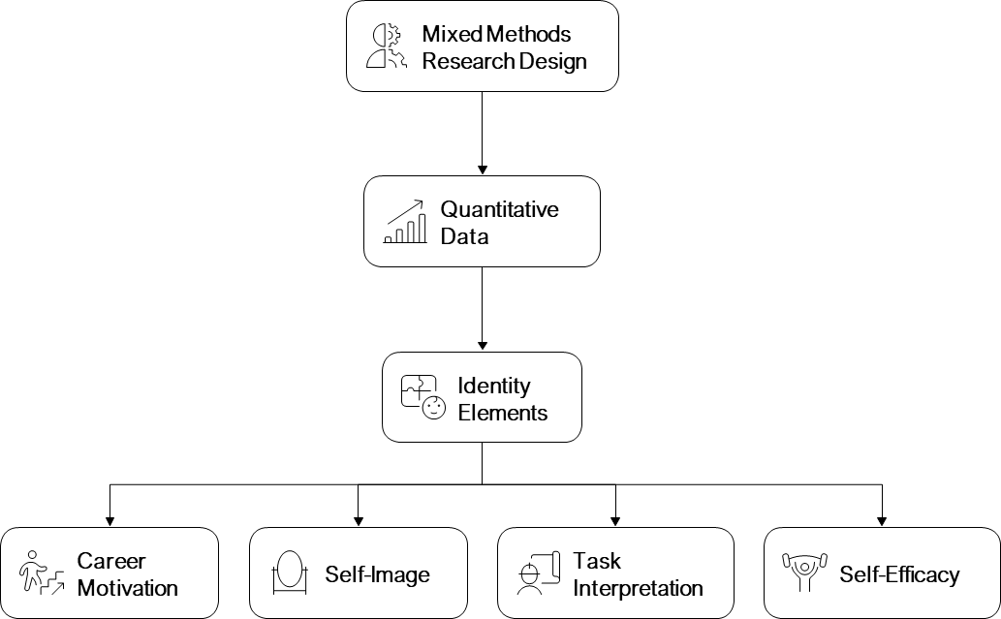
3. research Methods
Currently, we have entry data available from several institutions, utilising a mixed methods research design (Clark & Creswell, 2011) with a focus on quantitative data.
For our quantitative variable system, we adopted the identity elements identified by Hanna (2020), which include:
(1) Career motivation, (2) Self-image, (3) Task interpretation, (4) Self-efficacy
We integrated several validated tools to examine each identity element.
To understand different perspectives, we utilised scales from TALIS (2018) and de Vries (2013).
To analyse the learning environment, specifically regarding induction courses and practice, we employed an adapted version of the coherence scale developed by Canrinus et al. (2017) (Rapos et al., 2022).
For mapping learning activities, we used question sets created by Rapos et al. (2020, 2022).
Notes:
We used a mixed-methods design, but in this talk I will focus only on the quantitative results.
We organised our questions around four main elements of professional identity: career motivation, self-image, task interpretation, and self-efficacy.
We also asked about the learning environment and the tasks students did during their practice

Slide 7
4. Set of research variables
Personal factors of teacher identity (Hanna, 2020) | career motivation (Fit - Choice, 2007 based on Paksi 2023) teacher self-image (Hanna, 2020) self-efficacy (Schwarzer-Jerusalem based on Kopp, 1993) role and task perception (Hanna, 2020) views on key characteristics of the SCT (TALIS, 2018) views on subsequent teaching (de Vries et al., 2013)
Interpreting context(Canrinus et al., 2017; Rapos et al, 2022) | Learning environment - course-related features: training integration and theory - coherence of practice process of understanding student objectives and relating them to the course objectives the possibility and functioning of individual learning pathways specificities of the course content feedback on personal learning outcomes embedded in the process quality of learning support
Learning activities(Rapos et al., 2022) | learning activities professional knowledge - domestic competences professional experience professional networks, belonging to a professional community
Background information | sex age institution, department
All scales used in the research show acceptable internal consistency.
Cronbach’s alpha values range between 0.646 and 0.891
Notes:
In this research, we used several scales that had already been tested in earlier studies.
To check their reliability in our own data, we calculated Cronbach’s alpha.
The variables include personal characteristics, the learning environment, the activities of the students, and their background

Slide 8
5. research participants
Population: students about to start their induction practice in 2024.
Sampling: conducted during the first sessions of the course
Institution | Participants | Percentage of women | Percentage of men
University of Debrecen | 48 | 68,8 | 31,3
Eötvös Loránd University | 143 | 70,1 | 29,9
University of Miskolc | 29 | 62,1 | 37,9
University of Nyíregyháza | 79 | 60,8 | 39,2
University of Pécs | 24 | 50 | 50
Total | 323 | 57,5 | 42,5
Notes:
We collected the data during the first sessions of the course.
This means the answers show their initial motivation and expectations, before they had any real teaching experience.

Slide 9
6. results: self efficacy and gender
In the analysis of two self-efficacy statements, we observed a significant relationship with gender, as indicated by the t-test results:
If someone opposes me, I find a way to achieve what I want.
M_{women}=3,45, SD_{women}=0,994 ; M_{men}=3,82, SD_{men}=0,943; t(311)=-3,261, p=0,001)
When I face a problem, I usually come up with several ideas for solving it.
  M_{women}=3,74, SD_{women}=0,892 ; M_{men}=3,97, SD_{men}=0,880; t(311)=-2,130, p=0,017)
  It is more common for men to focus on problem-solving and addressing students' resistance.
Notes:
In our data, we found two statements where men scored significantly higher than women.
First, men were more confident that they can reach their goals even when there is resistance.
Second, they were more confident that they can generate several ideas when facing a problem.
This means that men in our sample felt stronger in problem-solving and in dealing with resistance from students.

Slide 10
6. results: self efficacy and experience
In the case of self-efficacy, we found a significant relationship with teaching-related work experience for the following statements:
I can always solve difficult problems if I really want to.
It is not difficult for me to stick to my intentions and achieve my goals.
Thanks to my creativity, I know how to handle unexpected situations.
I am sure I can manage well in unexpected situations.
With sufficient effort, I can find a solution to almost any problem.
I can stay calm in the face of difficulties because I can rely on my problem-solving skills.
When I face a problem, I usually come up with several ideas for solving it.
Those with work experience: more confident, more creative, better at problem-solving.
Individuals with work experience tend to be more confident, more creative, and better at problem-solving.
Notes:
Students who already had some work experience in teaching or childcare scored higher in self-efficacy.
They felt more confident, more creative, and better at solving problems.
This means that practical experience helps to develop these skills.
It also shows that practice can strengthen teacher self-confidence, even at the very beginning of training.
A tanítással vagy neveléssel kapcsolatos korábbi munkatapasztalat jelentős összefüggést mutatott az énhatékonysággal.
A tapasztalattal rendelkező hallgatók magabiztosabbnak, kreatívabbnak és problémamegoldóbbnak értékelték magukat.
Ez jól mutatja, hogy a gyakorlati élmények már a képzés elején is erősítik a tanári önbizalmat.

Slide 11
6. results: self efficacy and professional communities
In the case of self-efficacy, we found a significant relationship with belonging to professional communities for the following statements:
Thanks to my creativity, I know how to handle unexpected situations.
  M_{yes}=4,08, SD_{yes}=0,824 ; M_{no}=3,80, SD_{no}=0,965; t(292)=-2,282, p=0,012)
I am sure I can manage well in unexpected situations.
M_{yes}=3,81, SD_{yes}=0,788 ; M_{no}=3,60, SD_{no}=1,022; t(161,621)=-1,799, p=0,037)
I can stay calm in the face of difficulties because I can rely on my problem-solving skills.
M_{yes}=3,97, SD_{yes}=0,844 ; M_{no}=3,72, SD_{no}=1,012; t(292)=-1,915, p=0,028)
Members of professional communities tend to be more confident, more creative, and calmer.
Notes:
Students who were members of professional communities scored higher in self-efficacy.
They felt more confident in handling unexpected situations and staying calm under pressure.
Professional communities give social support, shared experiences, and learning from others. So, these experiences provide not only knowledge but also emotional support.

Slide 12
6. results: Task interpretation and gender
We found a significant relationship between task interpretation and gender in several questions:
Women
It is important to teach students social interaction skills.
It is important to consider students’ wishes.
It is important that students in my class have a say in things.
It is acceptable for my students to criticise me sometimes.
Men
Order and discipline in the classroom are important to me.
Students must be quiet and pay attention in class.
It is important to me that everyone behaves well in class.
I expect commitment from my students.
Women: more sensitive to students’ needs. Men: place more emphasis on order and discipline.
Notes:
Our results show that task interpretation also differs by gender.
Female students gave more importance to social skills, listening to students, and letting them take part in classroom decisions. They also accepted some criticism from students.
Male students, on the other hand, focused more on keeping order and discipline.
So, women in this study were more focused on relationships and student voice, while men were more focused on rules and control.
Of course, these results only reflect tendencies in this group of students, and they may also be influenced by social expectations.

Slide 13
6. results: Task interpretation and work experience
Significant relationships were found between task interpretation and having work experience related to education in the following statements:
Students in my class must obey me.
M_{yes}=3,64, SD_{yes}=0,986 ; M_{no}=3,40, SD_{no}=0,984; t(292)=2,098, p=0,018)
I expect engagement from my students.
M_{yes}=3,55, SD_{yes}=1,034 ; M_{no}=3,27, SD_{no}=1,107; t(292)=2,227, p=0,013)
Key expectations: student engagement and obedience to the teacher.
Notes:
Students with previous work experience were more likely to expect students to obey the teacher and to be committed to learning.
This suggests that earlier work experience can strengthen the feeling that responsibility and teacher authority are important in the classroom.
Of course, it only reflects what we saw in this group.

Slide 14
6. results: Task interpretation and professional communities
In the case of task interpretation, we found a significant relationship with participation in professional communities for the following statements:
              Teaching students social interaction skills is my most important task.
      Education, in addition to teaching, is also my responsibility.
      If students learn a lot at school, they will have less chance of being unemployed in the future.
      Students need to learn a lot in school to succeed in society.
      I expect commitment from my students.
      It is important to consider students’ wishes.
      It is important that students in my class have a say in things.
Key focus: education, developing social competence, amplifying students’ voice
Notes:
For students who were members of professional communities, teaching was not the only important task.
They also saw education and the development of students’ social skills as essential.
They valued giving students a voice in the life of the class. So, belonging to a community here was linked with openness and with strengthening the students’ voice.

Slide 15
6. results: Carrier motivation and gender
There is a significant relationship between career motivation and the respondent’s gender in several statements.
Women
I believed I had the qualities of a good teacher.
(M_{yes}=3,34, SD _{yes} =0,647 ; M_{no}=3,30, SD_{no}=0,690; t(292)=3,422, p=0,000)
Teaching offers an opportunity to help socially disadvantaged people
(M _{yes} =3,04, SD _{yes} =0,891 ; M_{no}=3,02, SD_{no}=0,904; t(311)=2,605, p=0,005)
I like working with children/young people
(M _{yes} =3,52, SD _{yes} =0,742 ; M_{no}=3,14, SD_{no}=0,852; t(3292)=3,976, p=0,000)
MEN
I could not get into my preferred profession.
(M _{yes} =1,53, SD_{yes}=0,851 ; M_{no}=1,67, SD_{no}=0,956; t(311)=-2,231, p=0,013)
Teaching offered a predictable career path.
(M _{yes} =2,50, SD _{yes} =0,964 ; M_{no}=2,69, SD_{no}=0,914; t(311)=-2,575, p=0,005)
Teaching provides a predictable income.
(M _{yes} =2,33, SD _{yes} =1,051 ; M_{no}=2,49, SD_{no}=1,001; t(311)=-2,727, p=0,003)
Women: enjoy working with children and helping others.
Men: chose teaching for predictable income and career path, or because they could not enter their preferred profession.
Notes:
Our results show that women often chose teaching because they enjoy working with children and young people, and because they want to help disadvantaged groups.
Men, however, were more likely to say that they offers a stable career and income. Of course, this does not mean that all women or all men choose for these reasons.
It only reflects what we found in this group.

Slide 16
6. results: Carrier motivation and work experience
A significant correlation was found between career motivation and respondents' work experience in education regarding the following questions:
I made the choice to pursue a career in education because:
I believed I possessed the qualities of a good teacher.
I have always wanted to be a teacher.
Teaching offers a stable and predictable career.
It allows me to influence the development of young people.
I enjoy working with children and young adults.
Those with work experience: committed to a career in teaching.
Notes:
Previous teaching or childcare experience was also important here. Students with such experience were more committed to becoming teachers.
Many of them said that they had always wanted to work in education.
This shows that practical experience can make career choice stronger, even at the very beginning of teacher training.

Slide 17
6. results: Carrier motivation and professional communities
A significant correlation between career motivation and respondents' participation in professional communities was found for the following questions:
I chose a career in education because:
...through teaching I can serve society.
(M_{yes}=3,41, SD_{yes}=0,720 ; M_{no}=3,23, SD_{no}=0,836; t(292)=-1,597, p=0,056)
my teachers were inspiring.
(M_{yes}=3,35, SD_{yes}=0,898 ; M_{no}=3,15, SD_{no}=0,928; t(129,350)=-1,617, p=0,056)
Members of the professional community: have a teacher role model, serve the community
Notes:
Members of professional communities were more likely to say that they wanted to serve the good of society through teaching.
They also often mentioned that they had inspiring teachers in the past.
So, belonging to a community not only strengthens professional relationships today, but also brings positive role models from the past into focus.

Slide 18
Conclusions:
Among students beginning a Career Socialisation courses:
there is no significant difference in responses between those from different training institutions.
However, significant differences are observed by gender regarding self-efficacy, task interpretation, and career motivation.
University students who have teaching experience or are part of a student teaching community tend to have a stronger self-image.
The results of a longitudinal study will be important for understanding the following questions:
In what ways do students differ based on their place of education?
How do these differences vary by gender?
What changes occur in attitudes toward the teaching profession throughout the training period?
Notes:
In our research, we found no major differences between the universities where the courses take place. But gender does matter – it shapes how students see their skills, their teacher role, and their career motivations. Students with teaching experience or membership in professional communities are more confident and have a stronger teacher identity. In the coming years, we will repeat this study to see how these attitudes change during the training.

Slide 19
references
Andreasen, J. K., Bjørndal, C. R., & Kovač, V. B. (2019). Being a teacher and teacher educator: The antecedents of teacher educator identity among mentor teachers. Teaching and Teacher Education, 85, 281-291.
Anspal, T., Eisenschmidt, E., & Löfström, E. (2012). Finding myself as a teacher: Exploring the shaping of teacher identities through student teachers’ narratives. Teachers and Teaching, 18(2), 197-216.
Bandura, A. (1993). Perceived self-efficacy in cognitive development and functioning. Educational psychologist, 28(2), 117-148.
Beijaard, D., Meijer, P. C., & Verloop, N. (2004). Reconsidering research on teachers’ professional identity. Teaching and teacher education, 20(2), 107-128.
Beijaard, D., Koopman, M., & Schellings, G. (2023). Reframing teacher professional identity and learning. In The Palgrave handbook of teacher education research (pp. 763-785). Cham: Springer International Publishing.
Bentler, P. M. (2007). On tests and indices for evaluating structural models. Personality and Individual Differences, 42, 825–829. https://dx0x0oi.org/10.1016/j.paid.2006.09.024
Buitink, J., & Beijaard, D. (2007). Learning in school-based teacher education. In M. Munthe, & E. Zellermayer (Eds.), Teachers learning in communities: International perspectives. Sense Publishers.
Bullough, R. V. (1997). Practicing theory and theorizing practice. In J. Loughran & T. Russell (Eds.), Purpose, passion and pedagogy in teacher education (pp. 13–31). London: Falmer Press.
Canrinus, E. T., Bergem, O. K., Klette, K., & Hammerness, K. (2017). Coherent teacher education programmes: Taking a student perspective. Journal of Curriculum Studies, 49(3), 313-333.
Cohen, J. (1992). A power primer. Psychological Bulletin, 112, 155–159. https://doi.org/ 10.1037/0033-2909.112.1.155.
Clark, V. L. P., & Creswell, J. W. (2008). The mixed methods reader. Sage.
Cross, B. (2017). Teacher education as a creative space for the making of teacher identity. The SAGE handbook of research on teacher education, 2, 210-227.
Garner, J. K., & Kaplan, A. (2018). A complex dynamic systems perspective on teacher learning and identity formation: an instrumental case. Teachers and Teaching, 25(1), 7–33. https://doi.org/10.1080/13540602.2018.1533811
Gaziel, H. H. (1995). Sabbatical leave, job burnout and turnover intentions among teachers. International Journal of Lifelong Education, 14(4), 331-338.
Geijsel, F. P., Sleegers, P. J., Stoel, R. D., & Krüger, M. L. (2009). The effect of teacher psychological and school organizational and leadership factors on teachers' professional learning in Dutch schools. The elementary school journal, 109(4), 406-427.
Goddard, R. D., Hoy, W. K., & Hoy, A. W. (2000). Collective teacher efficacy: Its meaning, measure, and impact on student achievement. American educational research journal, 37(2), 479-507.
Goodson, I. F., & Cole, A. L. (1994). Exploring the teacher's professional knowledge: Constructing identity and community. Teacher Education Quarterly, 85-105.

Slide 20
references
Izadinia, M. (2013). A review of research on student teachers' professional identity. British educational research journal, 39(4), 694-713.
Kelchtermans, G. (1993). Getting the story, understanding the lives: From career stories to teachers' professional development. Teaching and teacher education, 9(5-6), 443-456.
Kelchtermans, G., & Hamilton, M. L. (2004). The dialectics of passion and theory: Exploring the relation between self-study and emotion. In International handbook of self-study of teaching and teacher education practices (pp. 785-810). Dordrecht: Springer Netherlands.
Kline, R. B. (2011). Convergence of structural equation modeling and multilevel modeling. In M. Williams (Ed.). Handbook of methodological innovation. Thousand Oask, CA: Sage.
Lauriala, A., & Kukkonen, M. (2005). Teacher and student identities as situated cognitions. In Connecting Policy and Practice (pp. 206-215). Routledge.
Little, T. D. (2013). Longitudinal structural equation modeling. New York, NY: Guilford.
Marušić, I., Jugović, I., & Lončarić, D. (2017). Approaches to learning of first-year and fifth-year student teachers: are there any differences?. European journal of teacher education, 40(1), 62-75.
Meijer, P. C., de Graaf, G., & Meirink, J. (2011). Key experiences in student teachers’ development. Teachers and Teaching: Theory and Practice, 17, 115–129.
Mockler, N. (2011). Beyond ‘what works’: Understanding teacher identity as a practical and political tool. Teachers and teaching, 17(5), 517-528.
Moore, M., & Hofman, J. E. (1988). Professional identity in institutions of higher learning in Israel. Higher education, 17(1), 69-79.
Nias, J. (2002). Primary teachers talking: A study of teaching as work. Routledge.
Olsen, B., Buchanan, R., & Hewko, C. (2023). Recent trends in teacher identity research and pedagogy. The Palgrave handbook of teacher education research, 867-890.
Paksi, B. (2023). Kitart-e a belső motiváció?–a (még) pályán lévő pedagógusok pályamotivációi. Educatio, 32(1), 68-84.
Pekrun, R., & Schutz, P. A. (2007). Where do we go from here? Implications and future directions for inquiry on emotions in education. In Emotion in education (pp. 313-331). Academic
Pillen, M. T., Den Brok, P. J., & Beijaard, D. (2013). Profiles and change in beginning teachers' professional identity tensions. Teaching and teacher Education, 34, 86-97.
Rapos, N., Bükki, E., Gazdag, E., Nagy, K., & Tókos, K. (2020). A pedagógusok folyamatos szakmai fejlődése és tanulása. Fogalmi változások. Neveléstudomány, Oktatás–Kutatás–Innováció 8(1), 28–45
Rapos, N., Tókos, K., Nagy, K., Eszes, F., & Horváth, L. (2022). A pedagógusok folyamatos szakmai fejlődésének és tanulásának komplexitása. Neveléstudomány| Oktatás–Kutatás–Innováció, 10(1), 7-36.
Richter, E., Brunner, M., & Richter, D. (2021). Teacher educators’ task perception and its relationship to professional identity and teaching practice. Teaching and Teacher Education, 101, 103303.
Tsukawaki, R., Maki, T., Hirata, Y., Okahana, K., Shimoda, A., Tsushima, A., & Omori, M. (2023). Multidimensional Psychometrics of Teacher Educators’ Professional Identity: An Initial Validation with Teacher Educators in Southeast Asia. Education Sciences, 13(9), 943.
van Rijswijk, M. M., Bronkhorst, L. H., Akkerman, S. F., & van Tartwijk, J. (2018). Changes in sensed dis/continuity in the development of student teachers throughout teacher education. European Journal of Teacher Education, 41(3), 282-300.
Volkmann, M. J., & Anderson, M. A. (1998). Creating professional identity: Dilemmas and metaphors of a first‐year chemistry teacher. Science Education, 82(3), 293-310.
Zembylas, M. (2003). Emotions and teacher identity: A poststructural perspective. Teachers and teaching, 9(3), 213-238

Slide 21
lenard.sandor@ppk.elte.hu
Thank you for your attention!

