Slide 1

School Organization, Teacher Education and Professional Learning Research Group
Supporting the training of school-based teacher educators as a means of redefining positions of power
Currents in Education: Navigating Change in Languages, Cultures, and Communities - IAIE 2025
Krisztina Czető, PhD., Assistant Professor
Katalin Tókos, PhD., Assistant Professor
Sándor Lénárd, PhD., Habil. Associate Professor
Nóra Rapos, PhD., Habil. Associate Professor

Slide 2


.relevance of the research
teacher training now occurs in a variety of settings across multiple locations, with a proliferation of alternative learning pathways (White, 2019)
growing teacher shortage in Europe
emphasis on identifying teachers working in schools as teacher educators, while they continue to teach their students as teachers
being a dual-identity professionals (a new expectation) (White & Berry, 2022)
constant boundary crossing (at the school-university interface) (Dengerink et al., 2015; Kaasila et al., 2023),
"going from expert to novice" (Kaasila et al. 2023)

Slide 3

1. Research design
2025 August
Innovation and development
prototyping
development-based design research:
research-based solutions to complex problems in educational practice: supporting school teachers in becoming teacher educators,
to expand our knowledge about the characteristics of these interventions: teacher education development and professional community building based on a specific collaboration
study the individual and the environment as a system (see Barab, 2012)
the product (design): the development of a framework for supporting the identity formation of school teachers in a collaborative setting
(embedded in the career socialisation course in the Hungarian teacher education)
Generate Research-Based Solutions: development
Literature review
Needs and context analysis
Implementation
Exploratory phase
Implementation

Slide 4
2. Aims and research questions
This study focuses on designing and testing a collaborative system model for supporting the development of a teacher-educator community.
How does the identity of school-based teacher educators develop during their entry into and participation in teacher education? (This includes understanding the transition and changes.)
How do personal and professional characteristics influence the identity of school-based teacher educators when they enter into teacher education and after the collaboration?
In what ways does the personal pedagogy of teacher education (related to professional characteristics) shape the identity of school-based teacher educators during their entry into teacher education and after collaboration?
What learning activities contribute to the process of becoming a teacher educator?
What contextual factors influence the identity construction of school-basedx teacher educators, (and how do they do so)?

Slide 5
collaborative workshops
interviews
reflective diaries
course development
system model
Literature review
narrative literature review
systematic literature review
Generate Research-Based Solutions: development
Needs and context analysis
Implementation
role of school-based teacher educators in Hungary
Exploratory phase
Innovation and development
prototyping
Implementation
2024 August
2025 August

Slide 6
3. Literature review
Teacher professional identity
Teacher identity research is very diverse (see also Rushton et al. (2023):
theoretical frameworks and models of professional life;
narratives of professional life: narrative interpretation of identity;
becoming a teacher (career starters’ identity);
the role of context (professional policy, institutional and international/intercultural dimensions);
the identity-forming effect of communities;
change, transition and conflict;
subject-specific and field-specific identity of teachers.
Narrative literature review (Czető et al., 2024):
explored the theoretical foundations of empirical research on identity formation among school-based teacher educators
Identity and professional learning
Teacher educators
Teacher educators’ identity
Teacher educators’ identity and learning

Slide 7
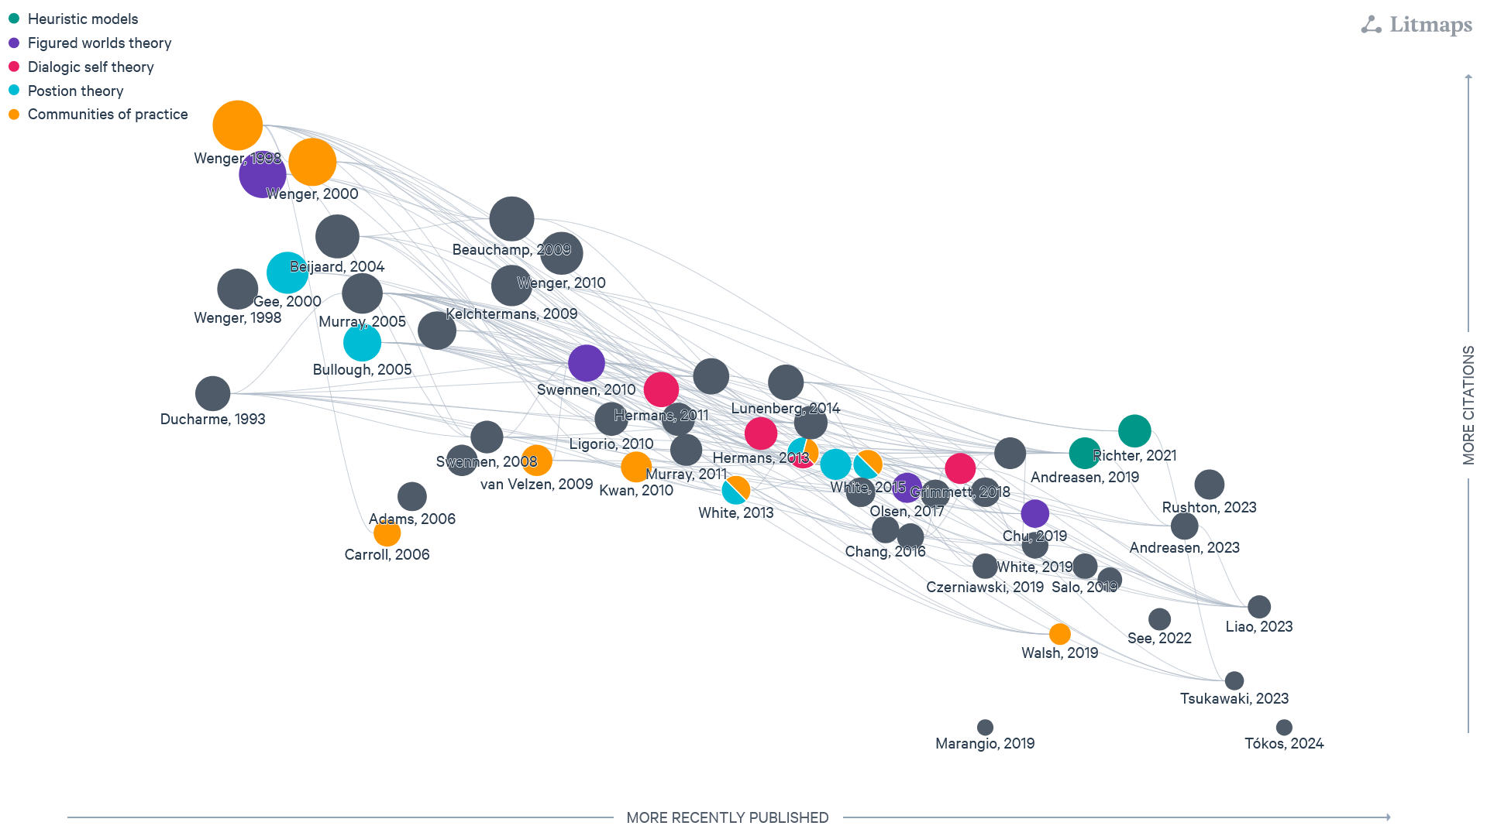

Slide 8
3. Literature review
Our analysis identified five main theories forming the research of school-based teacher educators’ identity:
Communities of practice and identity theory (Carroll, 2006; Kwan & Lopez-Real, 2010; Walsh & Dolan, 2018; Wenger, 1998, 2010; White, 2014);
Figured worlds theory (Chu, 2019; Holland et al., 1998; Olsen & Buchannan, 2017; Swennen, Volmann & van Essen, 2008);
Dialogical-self theory (Hermans, 2013; Grimmet, 2018; White, 2014);
Position theories (Gee, 2000; Bullough, 2005; White, 2014)
Heuristic models (Andreasen, Bjørndal & Kovac, 2019; Richter, Brunner & Richter, 2021)(Czető et al., 2024)

Slide 9
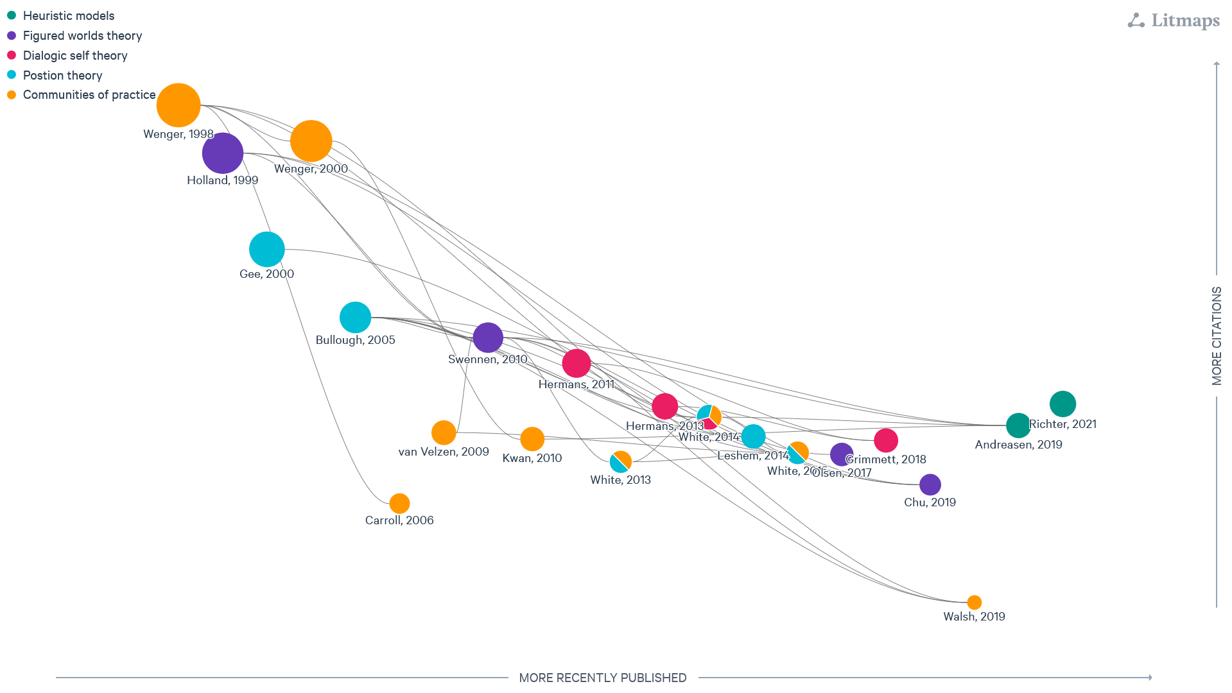

Slide 10
3. Theoretical background: Teachers’ professional identity
The development of professional identity is a process in which teachers themselves actively participate with their personal motivations and emotions while trying to answer questions that define their self-identity as teachers (Who am I as a teacher? What kind of teacher do I want to be?) (Beijaard et al., 2004; Izadinia, 2013; Rodrigues & Mogarro, 2019, Olsen, 2023).
The development of teacher identity is determined by context through the complexity and uniqueness of mutually interdependent multi-level systems (Olsen, 2008; Kennedy, 1997).

Slide 11
3. Theoretical background: Teachers’ professional identity
  it encompasses both the person and the context (i.e. it is shaped by relationships with others and interwoven with emotions);
changing, dynamic and unstable
1
2
3
4
consists of sub-identities
agency (capacity to act) is an important element of professional identity
(Beijaard et al., 2004; Tókos & Rapos, 2024)

Slide 12
3. Theoretical background: identity formation and learning
1. Research on teacher professional development and learning increasingly links teachers' professional learning to identity development (Boylan, 2017; Garner & Kaplan, 2018).
focus on discrete episodes of professional learning (not on longer-term professional learning/development) (Rapos et al., 2020).
2. Several common points can be identified in the interpretation of the two concepts:
characterised by open-ended systems, complexity, dynamism and context-embedded uniqueness,
they are considered processes, and their results are unique,
difficult to find integrative research and model-building efforts that can address complex, dynamic learning processes together.

Slide 13
3. Theoretical background: Teacher educators
Conceptual diversity (Andreasan, 2023; Berry & White, 2023 Czető et al., 2024):
university-based teacher educators (UBTE): diverse professional career paths of university teacher educators and their transition to teacher education (not necessarily preceded by experience in a school context (Andreasan, 2023; Berry & White, 2023);
non-university-based teacher educators (NUBTE) (Liao et al., 2023): an umbrella term; educators working outside the university context;
school-based teacher educators (SBTE) (Berry & White, 2023; Bullough, 2005; Kennedy & Bell, 2023)Bullough (2005):
an important element of the professional identity of school-based teacher educators (SBTE) their embeddedness in the school (they are strongly attached to their schools and work there, but they may also be linked to universities in the context of certain activities and tasks).

Slide 14
3. Theoretical background: School-based Teacher educators
dual professionals with hybrid, multiple identities, ‘identity dissonance’ (Warin & Dempster, 2007),
a solid professional identity in their own school environment (as effective classroom teachers),
feeling that, as second-order practitioners, they do not necessarily have sufficient expertise to guide teachers' professional learning, and their sense of self-efficacy in this area is lower.
two worlds paradox (Olsen and Buchanan, 2017)
Two worlds paradox
School teacher
identity
Teacher Educator
Identity
classroom expertise and
confidence
not necessarily sufficient expertise lower self-efficacy
Navigating Dual Professional Identities

Slide 15
4. results
Professional learning experience
Our goal is:
to develop a comprehensive model that interprets the interplay between personal and contextual factors in the formation of teacher identity (complex, dynamic system model) (see Garner & Kaplan, 2018, 2019; Rapos et al., 2020, 2022).
personal and professional characteristics
Based on our exploratory literature review (Czető et al., 2024), we identified three identity-shaping factors in our model:
personal and professional characteristics (Garner & Kaplan, 2018; Andreasen et al., 2019; Grimmett et al., 2018),
the personal pedagogy of teacher education (Lunenberg (2014; Liao et al., 2023; Murray et al., 2020; Richter et al., 2021), and
institutional context and community characteristics (Andreasen et al., 2019).
pedagogy of teacher education
institutional context and the professional community characteristics
Identity construction/learning
teacher educator identity/sub-identity

Slide 16
4. results: Creating the third space
First order teaching
transformation
identification
First order teaching
Student learning
Boundary crossing
Student learning
reflection
coordination
Second-order teaching
Career socialisation course
Third space
See also Li et al. (2024)

Slide 17
4. results: Creating the third space
The concept
The Product (Design)
What is needed to become a trainer? Commitment (engagement), knowledge enrichment, practice development (Li, et al., 2024)
What activities does the school trainer carry out to support student learning?
How do they support the student?
What is the purpose of student learning?
What learning activities will you carry out during the practice?
Developing the internal structure of the "third space."
The boundary-crossing situation focused on a three-layered interpretation:
Exploring support for student learning;
Interpreting the role of educators in facilitating student learning;
Understanding the process of becoming a teacher educator and supporting learning.

Slide 18
4. results: Creating the third space
This concentric structure supports:
  teachers reflect on their roles as teacher educators by interpreting student learning.
  encourages them to reconsider their own development and that of their fellow educators.
  This process created a space for gathering ideas to develop a system model aimed at supporting the journey of becoming a teacher educator.
Becoming a teacher educator
University students’ learning
Understanding the role of teacher educators to support learning

Slide 19
4. results:
Redefining Power relations: empowerment, enablement and engagement
Collaboration between 12 teachers (from 4 selected schools) and university teachers. The school teachers became members of the research group.
Four researchers were intentionally selected for their direct involvement with the schools as university trainers;
at carefully planned feedback points, the trainers who were in contact with the schools shared their experiences with each other, and the school trainers and the entire research group;
Personal reflective diaries were maintained throughout the process.
Four half-day workshops.
A diagnostic tool will be integrated into a Learning Management System (LMS).
Use of design methods to support partnership (Persona Method, Q-methodology, design mapping).
School-based teacher educator identity
Practice Development
reflective diaries
collaborative system model
LMS
Knowledge Acquisition
collaborative workshops
use of design methods
Engagement
collaborative workshops

Slide 20
Conclusions:
Redraw the balance between schools and universities by supporting boundary crossing and eliminating hierarchical relations through the fostering of professional learning communities.
The initiative aims to support the development of a community for teacher education by creating a model that promotes the professional learning and identity formation of school-based teacher educators.
It may be possible to develop a system that not only strengthens cooperation between universities and school-based teacher educators but also creates a model for the system itself.

Slide 21
Thank you for your attention!

Slide 22
references
Adams, K., Hean, S., Sturgis, P. & Clark, J. M. (2006). Investigating the factors influencing professional identity of first-year health and social care students. Learning in Heatlh and Social Care, 5(2).
Andreasen, J. K. (2023). School-based mentor teachers as boundary-crossers in an initial teacher education partnership. Teaching and Teacher Education, 122. https://doi.org/ 10.1016/j.tate.2022.103960
Andreasen, J. K., Bjørndal, C. R. P. & Kovač, V. B. (2019). Being a teacher and teacher educator: The antecedents of teacher educator identity among mentor teachers. Teaching and Teacher Education, 85, 281–291. https://doi.org/10.1016/j.tate.2019.05.011
Beauchamp, C. & Thomas, L. (2009). Understanding teacher identity: an overview of issues in the literature and implications for teacher education. Cambridge Journal of Education, 39(2), 175–189. https://doi.org/10.1080/03057640902902252
Beijaard, D., Meijer, P. C. & Verloop, N. (2004). Reconsidering research on teachers' professional identity. Teaching and Teacher Education, 20(2), 107–128. https://doi.org/10.1016/j.tate.2003.07.001
Bullough, R. V. Jr. (2005). Being and becoming a mentor: School-based teacher educators and teacher educator identity. Teaching and Teacher Education, 21(2), 143–155.
Carroll, D. M. (2006). Developing Joint Accountability in University-School Teacher Education Partnerships. Action in Teacher Education, 27(4), 3–11. https://doi.org/10.1080/01626620.2006.10463396
Chang, A., Rak Neugebauer, S., Ellis, A., Ensminger, D., Marie Ryan A., & Kennedy, A. (2016). Teacher Educator Identity in a Culture of Iterative Teacher Education Program Design: A Collaborative Self-Study. Studying Teacher Education, 12(2), 152–169. https://doi.org/10.1080/17425964.2016.1192030
Chu, Y. (2019). Mentor teacher professional identity development in a year-long teacher residency. Mentoring & Tutoring: Partnership in Learning, 27(3), 251–271. https://doi.org/10.1080/13611267.2019.1630991
Czerniawski, G., Kidd, W. & Murray, J. (2013). Understanding teacher educators as teachers of teachers: Exploring multiple perspectives. Presentation at the AERA Conference, San Francisco, USA. May 1. Education and Poverty: Theory, Research, Policy and Praxis.
Czerniawski, G., Kidd, W., & Murray, J. (2019). We are all teacher educators now: Understanding school-based teacher educators in times of change in England. In Swennen, A., Kosnik, C. & Murray, J. (Eds.), International research, policy and practice in teacher education (pp. 171–185). Springer.
Ducharme, E. R. (1993). The lives of teacher educators. Teachers College Press.
Gee, J. P. (2000). Identity as an Analytic Lens for Research in Education. Review of Research in Education, 25(1), 99–125. https://doi.org/10.3102/0091732X025001099
Grimmett, H., Forgasz, R., Williams, J., & White, S. (2018). Reimagining the role of mentor teachers in professional experience: moving to I as fellow teacher educator. Asia-Pacific Journal of Teacher Education, 46(4), 340–353. https://doi.org/10.1080/1359866X.2018.1437391
Hermans, H. J. M. (2013). The dialogical self in education: Introduction. Journal of Constructivist Psychology, 26(2), 81–89.
Hermans, H. J. M. & Gieser, T. (Eds.) (2012). Handbook of dialogical self theory. Cambridge University Press.
Holland, D., Lachiocotte, W., Skinner, D. & Cain, C. (1998). Identity and agency in cultural worlds. Harvard University Press.
Jackson, A. & Burch, J., 2018. New directions for teacher education: Investigating school/university partnership in an increasingly school-based context. Professional Development in Education, https://www.tandfonline.com/doi/full/10.1080/19415257.2018.1449002
Kálmán, O. (2019). A felsőoktatás oktatóinak szakmai fejlődése: az oktatói identitás alakulása és a tanulás módjai, Neveléstudomány, 1, 74–97.
Kelchtermans, G. (2009). Who I am in how I teach is the message: self‐understanding, vulnerability and reflection. Teachers and Teaching, 15(2), 257–272. https://doi.org/10.1080/13540600902875332
Kennedy, A. & Bell, L. (2023). School-Based Teacher Educators: A Scottish Manifesto. In Menter, I. (Ed.), Palgrave Handbook of Teacher Education Research (pp. 503–528). Palgrave Macmillan. https://doi.org/10.1007/978-3-030-59533-3_2-1
Kwan, T. & Lopez-Real, F. (2010). Identity formation of teacher–mentors: An analysis of contrasting experiences using a Wengerian matrix framework. Teaching and Teacher Education, 26(3), 722–731. https://doi.org/10.1016/j.tate.2009.10.008
Leshem, S. (2014). How do teacher mentors perceive their role, does it matter? Asia-Pacific Journal of Teacher Education, 42(3), 261–274. https://doi.org/10.1080/1359866X.2014.896870
Liao, W., Li, X., Dong, Q. & Wang, Z. (2023). Non-university-based teacher educators' professional learning: A systematic review. Teaching and Teacher Education, 136. Elsevier BV. https://doi.org/10.1016/j.tate.2023.104374
Ligorio, M. B. (2010). Dialogical Relationship between Identity and Learning. Culture & Psychology, 16(1), 93–107. https://doi.org/10.1177/1354067X09353206
Livingston, K. (2014). Teacher educators: Hidden professionals? European Journal of Education, 49(2), 218–232.
Lunenberg, M., Dengerink, J. & Korthagen, F. (2014). The Professional Teacher Educator: Roles, Behaviour, and Professional Development of Teacher Educators. Sense Publishers.
Marangio, K., Cooper, R., & Berry, A. (2019). Science teachers’ views on co-teaching with science teacher educators in preservice teacher education. Paper presented at the biannual conference of the European Science Education Research Association, Bologna, Italy, 26–30 August, 2019.
Mayer, D., Mitchell, J., Santoro, N. & White, S. (2011). Teacher educators and ‘accidental’ careers in academe: An Australian perspective. Journal of Education for Teaching, 37(3), 247–260. https://doi.org/10.1080/02607476.2011.588011
Muray, J., & Male, T. (2005). Becoming a teacher educator: evidence from the field. Teaching and Teacher Education, 21(2), 125–142. https://doi.org/10.1016/j.tate.2004.12.006
Murray, J., Czerniawski, G. & Barber, P. (2011). Teacher educators’ identities and work in England at the beginning of the second decade of the twenty-first century. Journal of Education for Teaching, 37(3), 261–277. https://doi.org/10.1080/02607476.2011.588014
Murray, J., Kidd, W., McMahon, A. & Viswarajan, S. (2020). Teacher educators and expansive learning in the workplace and beyond. Frontiers in Education, 5(84). https://doi.org/10.3389/feduc.2020.00084
Olsen, B. & Buchanan, R. (2017). “Everyone Wants You to Do Everything”: Investigating the Professional Identity Development of Teacher Educators. Teacher Education Quarterly, 44(1), 9–34.
Pereira, F., Lopes, A. & Marta, M. (2015). Being a teacher educator: professional identities and conceptions of professional education. Educational Research, 57(4), 451–469. https://doi.org/10.1080/00131881.2015.1078142
Richter, E., Brunner, M. & Richter, D. (2021). Teacher educators’ task perception and its relationship to professional identity and teaching practice. Teaching and Teacher Education, 101. https://doi.org/10.1016/j.tate.2021.103303
Rushton, E. A. C., Rawlings Smith, E., Steadman, S. & Towers, E. (2023). Understanding teacher identity in teachers' professional lives: A systematic review of the literature. Review of Education, 11(2). https://doi.org/10.1002/rev3.3417
Salo, A., Uibu, K., Ugaste, A. & Rasku-Puttonen, H. (2019). The challenge for school-based teacher educators: establishing teaching and supervision goals. Teacher Development, 23(5), 609–626. https://doi.org/10.1080/13664530.2019.1680426
See, B., Gorard, S., Morris, R. & Ventista, O. (2023). Rethinking the Complex Determinants of Teacher Shortages. In Menter, I. (Ed.), Palgrave Handbook of Teacher Education Research (pp. 75–103). Palgrave Macmillan. https://doi.org/10.1007/978-3-030-59533-3_2-1
Swennen, A., Jones, K. & Volman, M. (2010). Teacher educators: their identities, sub‐identities and implications for professional development. Professional Development in Education, 36(1–2), 131–148. https://doi.org/10.1080/19415250903457893
Swennen, A., Volman, M. & van Essen, M. (2008). The development of the professional identity of two teacher educators in the context of Dutch teacher education. European Journal of Teacher Education, 31(2), 169–184. https://doi.org/10.1080/02619760802000180
Tókos, K. & Rapos N. (2024). Pedagógusból tanárképzővé válni – az identitáskonstrukció egy lehetséges értelmezési kerete és vizsgálati lehetősége. Neveléstudomány, 3.
Tsukawaki R, Maki T, Hirata Y, Okahana K, Shimoda A, Tsushima A, Omori M. (2023). Multidimensional Psychometrics of Teacher Educators’ Professional Identity: An Initial Validation with Teacher Educators in Southeast Asia. Education Sciences, 13(9), 943. https://doi.org/10.3390/educsci13090943
Uibu, K., Salo, A., Ugaste, A. & Rasku-Puttonen, H. (2017). Beliefs about teaching held by student teachers and school-based teacher educators. Teaching and Teacher Education, 63, 396–404.
Van Velzen, C. & Volman, M. (2009). The activities of a school‐based teacher educator: a theoretical and empirical exploration. European Journal of Teacher Education, 32(4), 345–367. https://doi.org/10.1080/02619760903005831
Walsh, T., & Dolan, R. (2018). Changing identities and practices: transitioning from the role of supervisor to placement tutor in initial teacher education in Ireland. Professional Development in Education, 45(4), 527–538. https://doi.org/10.1080/19415257.2018.1427131
Warin, J. & Dempster, S. (2007). The salience of gender during the transition to higher education: Male students’ accounts of performed and authentic identities. British Educational Research Journal, 33(6), 887–903.
Wenger, E. (1998). Communities of practice: Learning, meaning, and identity. Cambridge University Press. https://doi.org/10.1017/CBO9780511803932
Wenger, E. (2010). Communities of Practice and Social Learning Systems: The Career of a Concept. In Blackmore, C. (Ed.), Social Learning Systems and Communities of Practice, (pp. 179–198). Springer. https://doi.org/10.1007/978-1-84996-133-2_11
White, E. (2013). Being a teacher and a teacher educator – developing a new identity? Professional Development in Education, 40(3), 436–449. https://doi.org/10.1080/19415257.2013.782062
White, E. (2013). Exploring the professional development needs of new teacher educators situated solely in school: Pedagogical knowledge and professional identity. Professional Development in Education, 39(1), 82–98.
White, E., Dickerson, C. & Weston, K. (2015). Developing an appreciation of what it means to be a school-based teacher educator. European Journal of Teacher Education, 38(4), 445–459. https://doi.org/10.1080/02619768.2015.1077514
White, S. (2019). Once were teachers? Australian teacher education policy and shifting boundaries for teacher educators. European Journal of Teacher Education, 42(4), 447–458. https://doi.org/10.1080/02619768.2019.1628214
White, S. (2019). Teacher educators for new times? Redefining an important occupational group. Journal of Education for Teaching, 45(2), 200–213.
White, S., & Berry, A. (2023). School-Based Teacher Educators: Understanding Their Identity, Role, and Professional Learning Needs as Dual Professionals. In I. Menter (Ed.), Palgrave Handbook of Teacher Education Research (pp. 257–274). Palgrave Macmillan. https://doi.org/10.1007/978-3-030-59533-3_2-1
White, S. & Forgasz, R. (2017). Supporting mentoring and assessment in practicum settings: A new professional development approach for school-based teacher educators. A companion to research in teacher education. Springer.
Williams, J., Ritter, J. & Bullock, S. M. (2012). Understanding the Complexity of Becoming a Teacher Educator: Experience, belonging, and practice within a professional learning community. Studying Teacher Education, 8(3), 245–260. https://doi.org/10.1080/17425964.2012.719130
Zeichner, K. (2007). Accumulating Knowledge Across Self-Studies in Teacher Education. Journal of Teacher Education, 58(1), 36–46. https://doi.org/10.1177/0022487106296219

